Slide 1
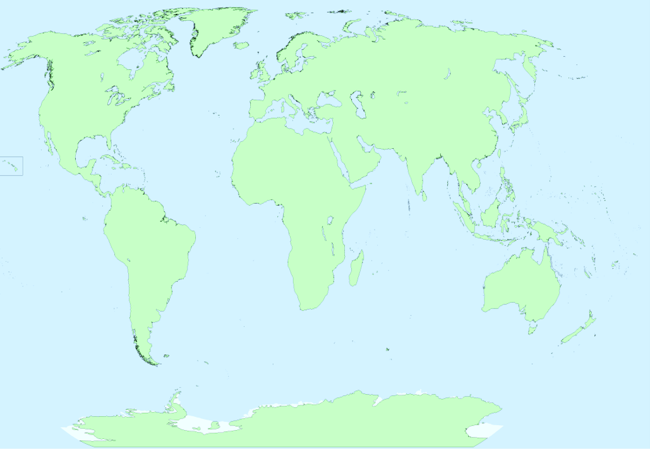

Spring Term
Computing
Touch Typing
Discuss the need for correct posture when typing.
Introduce typing terminology
Practise and improve typing skills
Start to type words
Improve the speed and efficiency of typing skills
Email
Open and respond to an email
Write an email to someone, using an address book
Learn how to use email safely
Add an attachment to an email
Branching Databases
Sort objects using YES/No questions
Complete a branching database
Create their own branching database
English
Listen to and discuss a wide range of texts
Prepare and perform poetry
Discuss words and phrases that capture the reader’s interest and imagination
Write their own poem linked to extreme weather
Write a description of a storm that includes the literary device of personification and then produce an interactive multimedia eBook
Setting descriptions – Escape from Pompeii
Persuasive writing – creating a holiday brochure
Art
Artist study - Hokusai – The Great Wave
Create a 3D volcano
Using clay to create ammonites
Create a holiday t-shirt
Plant sketching
PSHE
What makes a community?
Consider community, belonging to groups, similarities and differences and respect for others
Why should we eat well and look after our teeth?
Look at how to eat healthy, how to maintain good oral hygiene
Know when and where to ask for advice and help about healthy eating and dental care
R.E.
Hinduism
Know some of the beliefs and practices of Hindus
Understand why worship is important to the Hindu community
How are earthquakes and volcanoes formed?
Music
Recorder – Specialist Teacher
P.E.
Badminton – external coach
Gymnastics
Dance
Fitness/healthy lifestyle
MFL
Be able to use key phrases
Follow action commands
Count up to 10
Know key landmarks
Visit – Beamish Museum
Geography
Earthquakes and volcanoes
Describe and explain what causes an earthquake
Know why earthquakes happen at some locations but not others
Describe how the magnitude of an earthquake is measured
Describe and explain what causes a volcano
Identify the population of the countries of Europe
Explain why volcanoes and earthquakes often occur at the same locations around the world
Identify and locate the ‘Pacific Ring of Fire’
Look at the location, cause and effects of the Christchurch earthquake
Look at the population of the countries of Europe
Compare and contrast the country of Italy and the United Kingdom
Science
Rocks
Compare and group together different kinds of rocks
Describe how fossils are formed
Recognise that soils are made from rocks and organic matter
Plants
Identify and describe the function of different parts of flowering plants.
Explore the requirements of plants for life and growth and how they vary from plant to plant.
Investigate the way in which water is transported within plants.
Explore the part that flowers play in the life cycle of flowering plants.
Maths
Know the 3, 4 and 8-times tables
Multiply and divide 2-digits by 1-digit
Count money in pounds and pence
Add money and subtract money
Draw and interpret tally charts, pictograms, bar charts and tables
Measure length
Find equivalent lengths
Add and subtract lengths
Measure and calculate perimeter
Recognise and find a half, quarter and a third
Count in fractions.

