Slide 1

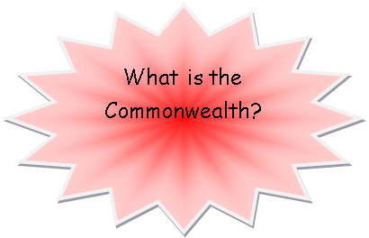




English
Novel: Wonder/ Can You See Me?
Poetry
Persuasive writing
Letter
Diary
Narrative – short story.
Developing the application of a range of skills through reading a range of fiction and non-fiction texts.
Develop the knowledge and application of a range of spelling, punctuation and grammar skills.
ICT
Create a picture based quiz for younger children.
Learn how to use different question types in a quiz.
Create a quiz for a teacher or parent.
Design a story based adventure game.
Code, test and debug their games.
Create a text based adventure upon a map.
Use the coding concepts of functions, two-way
selection and repetition in conjunction with one another to code their game.
MFL
Les vetements
J’habite
Un pays francophone
History and Geography
The Commonwealth Since 1945
What did Europe look like after World War 2?
What did the British Empire look like after World War Two?
What impact did Queen Elizabeth II have on the Commonwealth?
What is the Commonwealth like today?
PSHE
Discuss different types of relationships and begin to understand how their actions affect others.
Find out how differences and similarities between people arise from a number of factors.
Understand feelings associated with moving to secondary school and develop strategies to deal with those feelings.
Science
Humans and other Animas
Identify and explain the function of the organs of the human circulatory system? (heart, blood vessels, blood, blood pressure, clotting)
Identify and explain the function of the organs of the human gaseous exchange system (lungs, nose, throat, bronchi, bronchial tubes, diaphragm, ribs, breathing.)
Name and locate the major organs in the human body.
Make a diagram that outlines the main parts of a body.
Evolution and Interdependence
Give reasons for why living things produce offspring of the same kind.
Give reasons for why offspring are not identical with each other or with their parents.
Explain the process of evolution and describe the evidence for this.
Begin to appreciate that variation in offspring over time can make animals more or less able to survive in particular environments.
Talk about the life of Charles Darwin?
R.E.
The Influence of Faith on Believers
P.E.
Athletics
Rounders
Cricket
Art
Printing
Textiles
Art through maths
Design Technology
Cooking and Nutrition – Celebrating culture and seasonality
Where does our food come from?
What is seasonality?
Making a seasonal product
Evaluating the product
Maths
Formal national assessments (SATS)
Revision of topics
Test preparation
Summer Term
Consolidation of skills learned over the year.
Revisit – Shape and space, algebra, ratio and probability
Art in Maths
Number investigations
Music
Leavers’ Assembly preparation
Writing, learning and performing songs and music.
Ukulele

