Slide 1

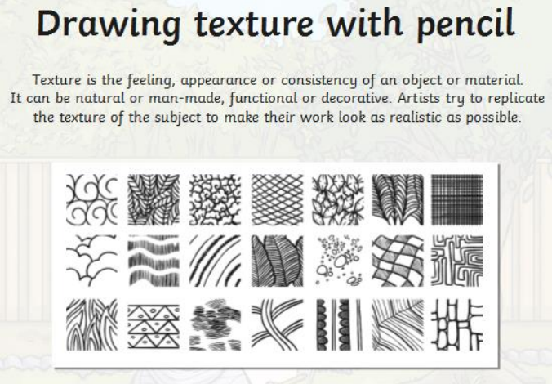
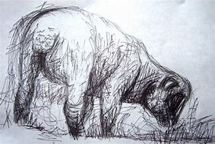
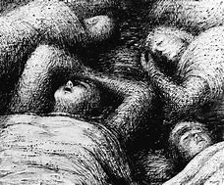
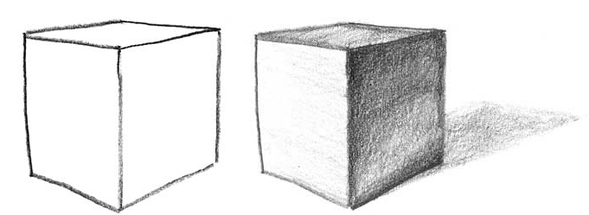
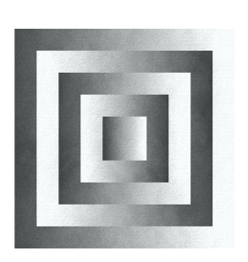
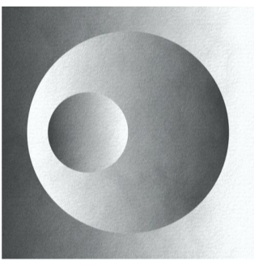
Year 6
Art - Henry Moore
Key Learning
Art is the creation of something personal, political, environmental that portrays a message to a viewer. Art can take many different forms and can use many different techniques, materials and technologies.
What's the difference between the types of pencils? The difference is seen in the type of lead is in the pencil. Most pencils use a system that gauges the hardness (written as H) of the lead to how black the mark the lead makes (written as B). Back in the day when they were deciding on what pencil people wanted to use most, they went with a middle of the road pencil - not too hard (H) and not too black (B) - that pencil is the No. 2 pencil that we all know. The No. 2 pencil is also known as an HB pencil, and the HB pencil is the middle of the hardness to blackness scale. The hardest lead in a pencil is a 9H pencil, the middle lead is HB (or No. 2), and the blackest lead is a 9B pencil.
Light and Shadow create depth and atmosphere in a drawing. In order to make a drawing look "realistic" you need shadow because in the real world everything has a shadow. If you draw something with only a line that is a consistent width, and don't render a shadow, your shape is going to look flat, two dimensional, and unrealistic. Adding shadow automatically adds a small bit of perspective to the drawing because the shadow indicates that something is in front of and/or behind the object that would cause it to cast a shadow. There are many ways to depict a shadow, it does not have to be a deep, rich, complex shadow, it can be as simple as varying the thickness of the line you create to draw the shape.
Henry Moore was an English artist who is famous for his abstract bronze sculptures which are located around the world as public works of art. As well as sculpture, Moore produced many drawings, including a series depicting Londoners sheltering from the Blitz during the Second World War, along with other graphic works on paper. His forms are usually abstractions of the human figure, typically depicting mother-and-child or reclining figures.
Key Vocabulary
Contour | The outline of something
Drawing | A work of art made with a pencil, pen, crayon, charcoal, or other implements, often consisting of lines and marks (noun); the act of producing a picture with pencil, pen, crayon, charcoal, or other implements
Foreground | The area of an image—usually a photograph, drawing, or painting—that appears closest to the viewer –
Landscape | The natural landforms of a region; also, an image that has natural scenery as its primary focus.
Monochrome | A work of art rendered in only one colour
Pattern | A series of events, objects, or compositional elements that repeat in a predictable manner.
Perspective | Technique used to depict volumes and spatial relationships on a flat surface, as in a painted scene that appears to extend into the distance.
Shade | In painting, a colour plus black
Shape | The form or condition in which an object exists or appears.
Sketch | A rendering of the basic elements of a composition, often made in a loosely detailed or quick manner. Sketches can be both finished works of art or studies for another composition.
Tone | The lightness or darkness of a colour. In painting, a colour plus grey.
Viewpoint | The position from which something is viewed or observed. Vista - a long, narrow view as between rows of trees or buildings, especially one closed by a building or other structure.
How can shading make a piece of art more interesting?
How can shading and texture be used to change the mood of a piece of art?
Why do you think Henry Moore use pencil to create his art work depicting the London Underground during the Blitz? Was it effective?

