Slide 1

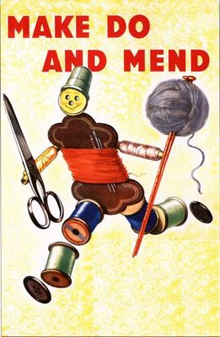
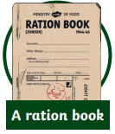
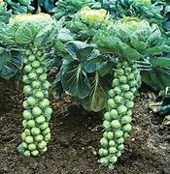
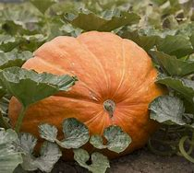
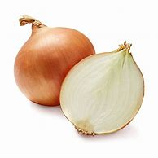
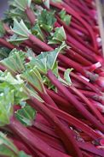
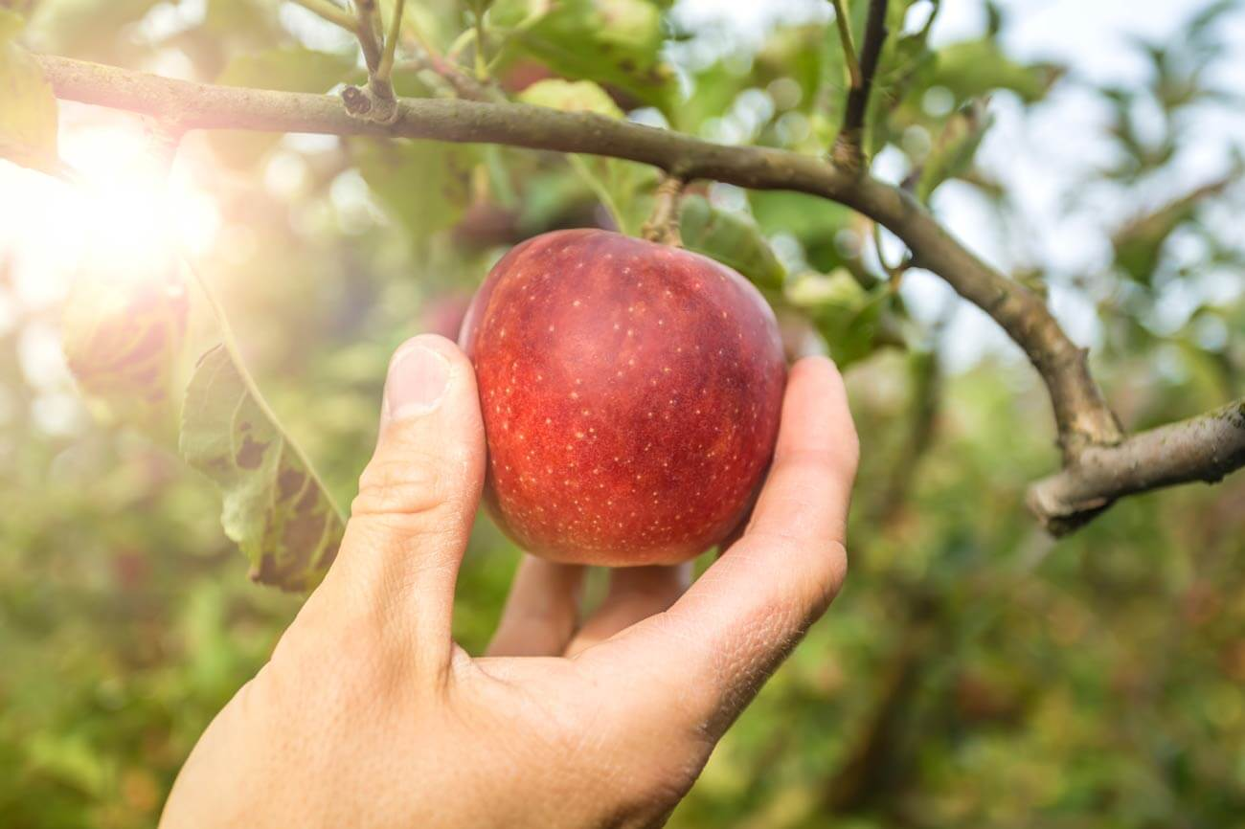
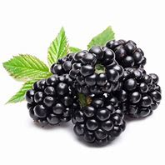
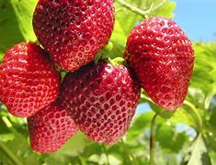
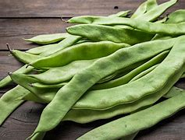
Year 6
Design Technology – Cooking and Nutrition
Key Learning
Climate conditions affect when food is produced in the UK. Seasonality is the time of year when a food type is at its best in terms of flavour or harvest. Some foods are required when they are out of season so producers grow them in hot houses/green houses in the UK or are imported into the country.
Rationing was a means of ensuring the fair distribution of food and commodities when they were scarce. It began shortly after the start of World War Two and continued for a number of years after the war ended.
Basic food stuffs such as sugar, meat, fats, bacon and cheese were directly rationed by an allowance of coupons. Housewives had to register with particular retailers. A number of other items, such as tinned goods, dried fruit, cereals and biscuits were rationed using a points system
Food wasn’t the only thing which was rationed. From June 1941 until 1949, buying new clothes was rationed in Britain. Make Do And Mend was a government campaign urging people to repair, reuse and reimage their existing clothes during the Second World War.
Key Vocabulary
Reared | to breed and raise an animal to use as food to be processed and eaten.
Grown | how something is grown from a seed to be processed and then eaten.
healthy | what we need to be fit and well
varied diet | a broad range of foods as part of our diets.
nutrition | a process providing and obtaining the food necessary for health and growth
users preferences | what a person would choose out of the options available to them
diet | the food that a person chooses to eat because of their wants, needs or values
Seasonality | The time of year when a food type is at its best and most wildly available
food hygiene | he safe handling, preparation, and storage of food
cross contamination | when bacteria or other microorganisms are unintentionally transferred from one object to another
evaluate | to look at a product and make judgements on what the advantages and disadvantages are.
manufacture | the process of producing and making products and goods
food miles. | how far the food has travelled to reach the end user
Is buying new always best?
How can we make the best out of what we have got?
Design a meal plan using only the portions available to a family during the war.
Seasonality
Autumn | Winter | Spring | Summer
Apple, Blackberry ,Butternut squash, Brussel Sprouts, Cabbage, Carrot, Cauliflower, Celery, Kale, Leek, Onion, Parsnip, Pear, Potato, Pumpkin, Spinach, Turnip. | Apple, Brussel Sprouts, Cabbage, Carrot, Cauliflower, Leek, Onion, Parsnip, Pear, Potato, Pumpkin, Rhubarb Swede, Turnip | Apple, Asparagus, Brussel Sprouts, Cabbage, Carrot, Cauliflower, Cucumber, Lettuce, Onion, Parsley, Potato, Radish, Red Onion, Rhubarb | Apple, Basil, Beans (Runner & French), Beetroot, Broccoli, Carrot, Cauliflower, Celery, Courgette, Cucumber, Fennel, Lettuce, Onion, Potato, Radish, Raspberry, Red Onion, Rocket, Rhubarb, Strawberry.

