Slide 1

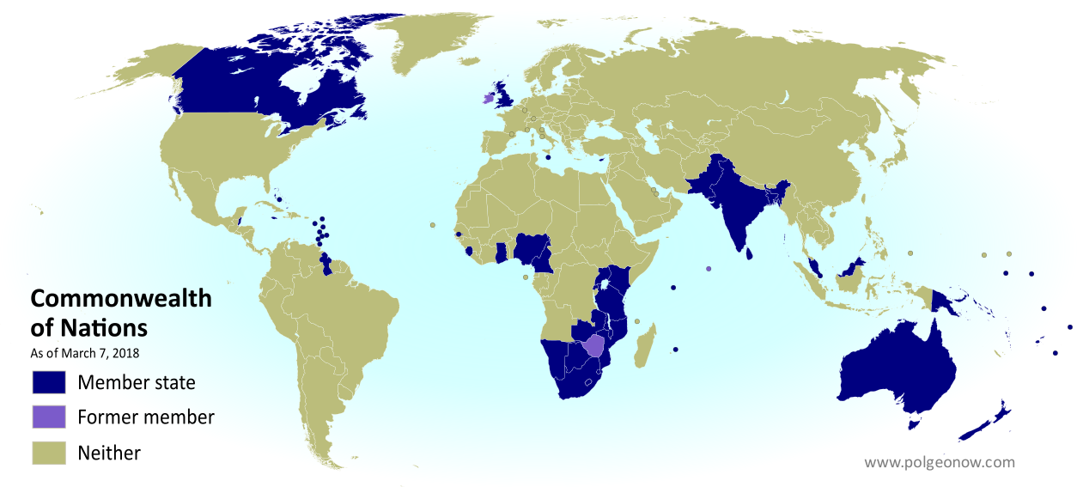
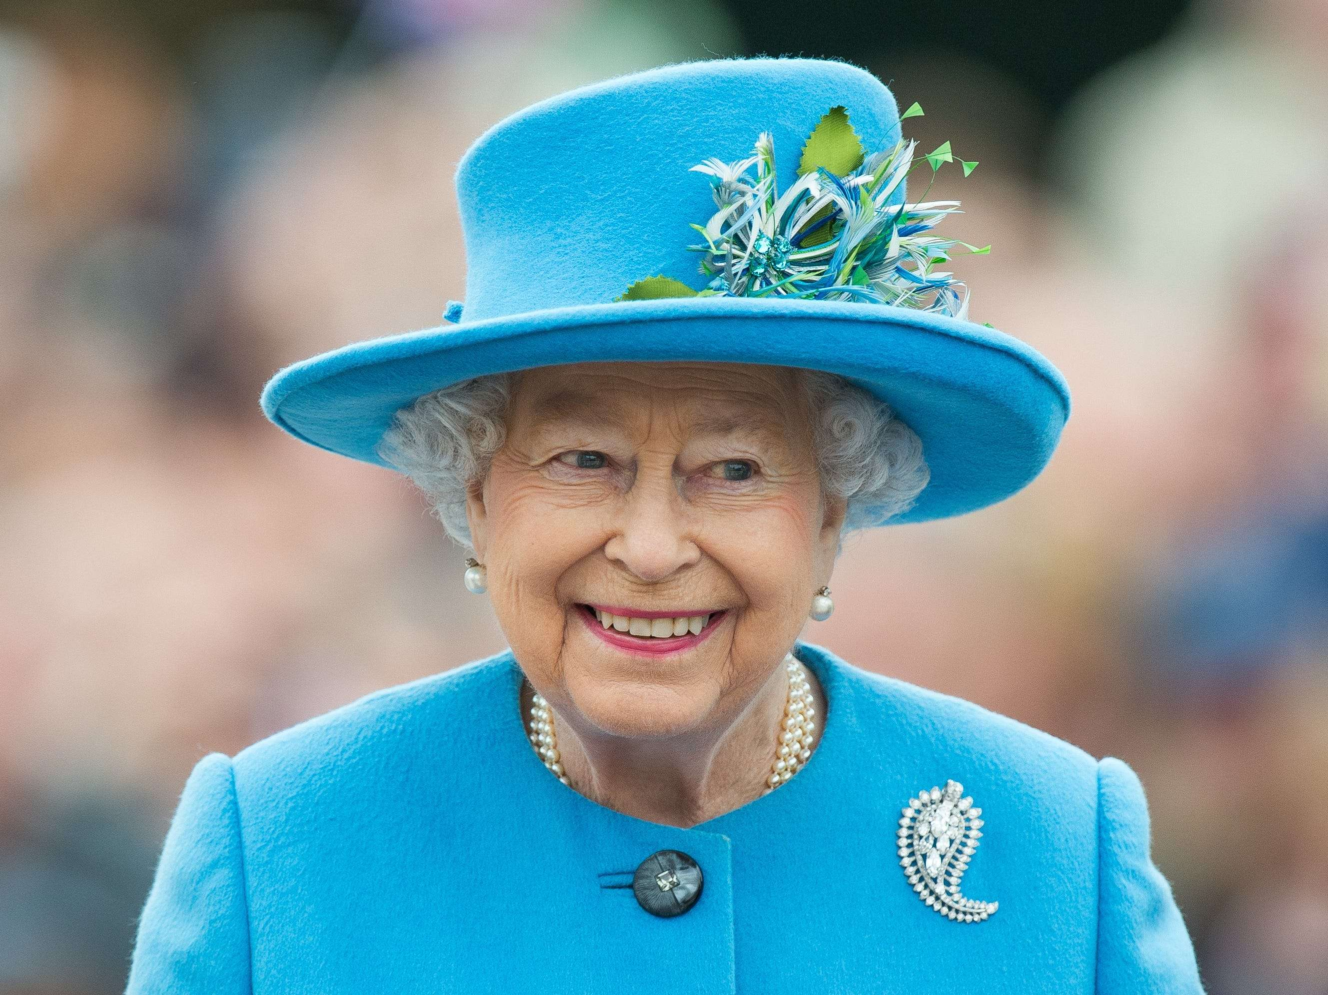
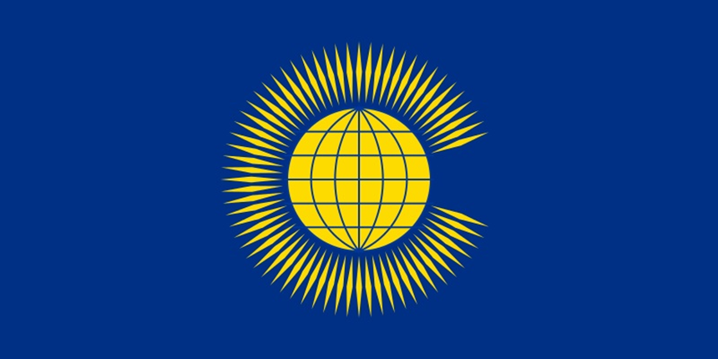
Year 6
Geography – The Commonwealth
Key Learning
There are 54 countries in the Commonwealth, in Africa, Asia, the Americas, Europe and the Pacific.
The Head of the Commonwealth is Her Majesty, Queen Elizabeth II
About 30% of the World’s population live in the Commonwealth. It includes some of the world’s largest countries like India as well as some of the smallest, like Grenada. The Commonwealth also contains both wealthy and poor countries
By the end of the 19th Century, the British Empire ruled about a quarter of the Earth’s population. These colonies were under direct rule of the British but many didn’t want to be. The first British colonies to gain independence were Canada and Australia. Even though they gained independence in the late nineteenth century, they still recognise the British monarchy today.
In 1931, the British Commonwealth of Nations was formed. Britain's former colonies chose whether or not they wanted to be part of it when they became independent. Most of the former colonies chose to join the Commonwealth. The last British colony to gain independence was Belize in 1981.
Key Vocabulary
Commonwealth | A group of 54 countries which recognise Queen Elizabeth as their monarch
Monarchy | A form of government with a king or queen at its head.
Empire | A group of states or countries ruled by a monarch
Colony | A place ruled by another country and occupied by people from that country.
Independence | When a country become independent from another country or Empire
Member countries | Countries which are part of the Commonwealth
Commonwealth Charter | A set of values and principles which commonwealth countries subscribe to
CHOGM | Commonwealth Heads of Government Meeting
Commonwealth Games | A sporting event held every 4 years in which Commonwealth countries compete in a range of sports
Are you a Milecastle Megamind?
How is the Commonwealth different from the British Empire?
How are the Commonwealth and World War 2 linked?
Do you think the Commonwealth is still a valuable part of our country?

