Slide 1

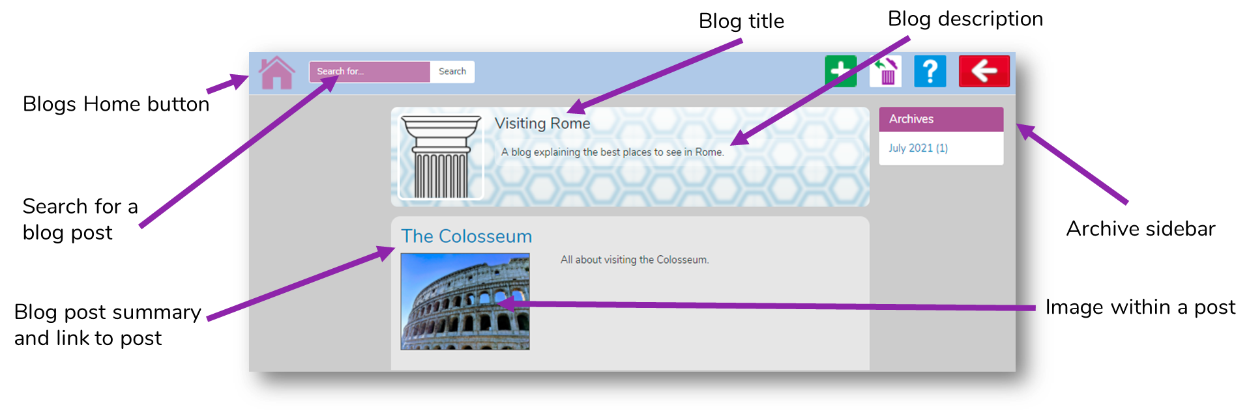
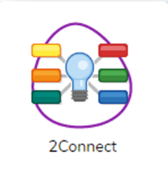
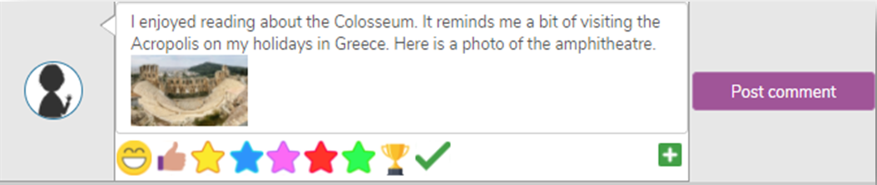
Year 6
Computing - Blogging
Key Learning
To identify the purpose of writing a blog.
To identify the features of a successful blog.
To plan the theme and content for a blog.
To understand how to write a blog and a blog post.
To consider the effect upon the audience of changing the visual properties of the blog.
To understand how to contribute to an existing blog.
To understand how and why blog posts are approved by the teacher.
To understand the importance of commenting on blogs.
Key Vocabulary
Approval | The act of acknowledging something is appropriate.
Archive | In this case, where older blog or vlog posts are stored.
Blog | A regularly updated website or web page, typically one run by an individual or small group, that is written in an informal or conversational style.
Blog post | A piece of writing or other item of content published on a blog.
Collaborate | Work jointly on an activity or project.
Commenting | To express an opinion or reaction in speech or writing.
Vlog | A personal website or social media account where a person regularly posts short videos
What is a blog?
What can a blog be about?
How are the audience involved in a blog?

