Slide 1

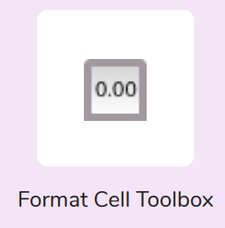
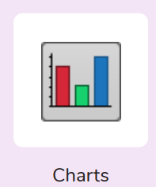

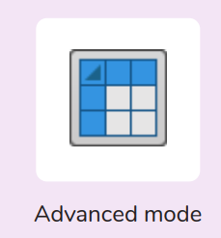
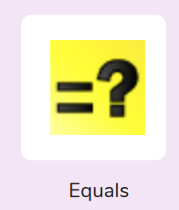
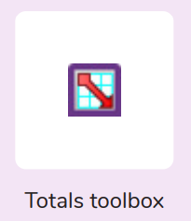
Year 6
Computing - Spreadsheets
Key Learning
To use a spreadsheet to investigate the probability of the results of throwing many dice.
To use a spreadsheet to calculate the discount and final prices in a sale.
To use a spreadsheet to plan how to spend pocket money and the effect of saving money.
To use a spreadsheet to plan a school charity day to maximise the money donated to charity.
Key Vocabulary
Advance mode | A mode of 2Calculate in which the cells have references and can include formulae.
Budget | The amount of money available to spend on a project.
Chart | A diagram that represents data. Charts include graphs and other diagrams such as pie charts or flowcharts
Columns | Boxes running vertically in a spreadsheet.
Count (How Many) Tool | Counts how many of a variable there are in a spreadsheet.
Data | A collection of information, especially facts or numbers, obtained by observation, questions or measurement to be analysed and used to help decision-making.
Expense | A cost associated with a project.
Formula | A group of letters, numbers, or other symbols which represents a scientific or mathematical rule. The plural of formula is formulae.
Format Cell | The way that text looks. Formatting cells is helpful for interpreting a cell’s contents for example you might want to format a cell to show a fraction e.g. 4 ½ or include units such as £ or $.
Formula Bar | An area of the spreadsheet into which formulae can be entered using the ‘=’ sign to open the fomula.
Profit | Money that is earned in trade or business after paying the costs of producing and selling goods and services.
Rows | Boxes running horizontally in a spreadsheet.
Spreadsheet | A computer program that represents data in cells in a grid of rows and columns. Any cell in the grid may contain either data or a formula that describes the value to be inserted based on the values in other cells.
How would you add a formula so that the cell shows the total of a column of cells?
What is a computational model and what it can be used for?
If you were going to use a spreadsheet to plan your dream holiday, what data would you collect to cost the trip?

