Slide 1

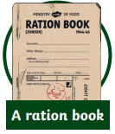
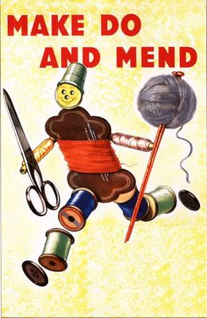
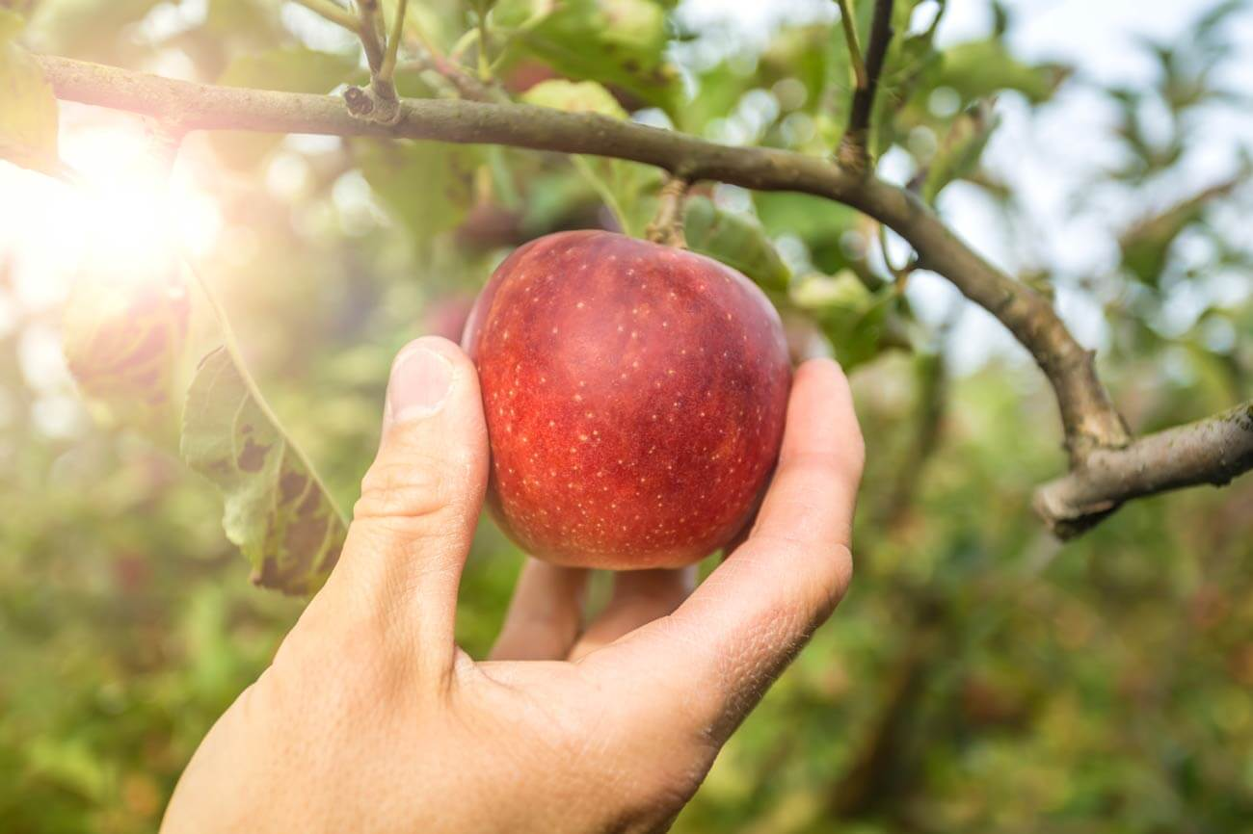
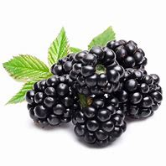
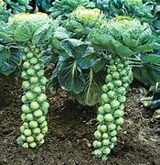
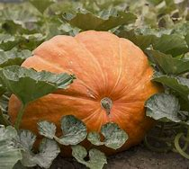
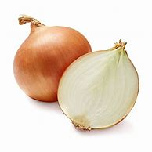
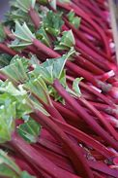
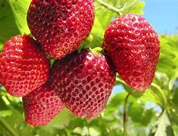
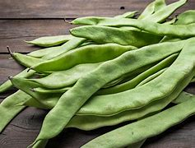
Year 6
Design Technology – Making Do
Key Learning
Climate conditions affect when food is produced in the UK. Seasonality is the time of year when a food type is at its best in terms of flavour or harvest. Some foods are required when they are out of season so producers grow them in hot houses/green houses in the UK or are imported into the country.
Rationing was a means of ensuring the fair distribution of food and commodities when they were scarce. It began shortly after the start of World War Two and continued for a number of years after the war ended.
Basic food stuffs such as sugar, meat, fats, bacon and cheese were directly rationed by an allowance of coupons. Housewives had to register with particular retailers. A number of other items, such as tinned goods, dried fruit, cereals and biscuits were rationed using a points system
Food wasn’t the only thing which was rationed. From June 1941 until 1949, buying new clothes was rationed in Britain. Make Do And Mend was a government campaign urging people to repair, reuse and reimage their existing clothes during the Second World War.
Key Vocabulary
Blender | To break food down until smooth
Dough | a mixture of flour, yeast and water before it is cooked.
Garlic Press | a tool to crush garlic into a pulp.
Gluten | A protein found in wheat, rye and barley
Grater | A tool to finely slice and chop firmer foods such as carrot or cheese
Knead | Pulling and squeezing dough to make it smooth
Peeler | A tool to remove the skin from a fruit or vegetable. May also be used to create thin ribbons of a food.
Seasonality | The time of year when a food type is at its best and most wildly available
Yeast | a tiny plant which makes bubbles of carbon dioxide when mixed with flour and warm water
Is buying new always best?
How can we make the best out of what we have got?
Design a meal plan using only the portions available to a family during the war.
Seasonality
Autumn | Winter | Spring | Summer
Apple, Blackberry ,Butternut squash, Brussel Sprouts, Cabbage, Carrot, Cauliflower, Celery, Kale, Leek, Onion, Parsnip, Pear, Potato, Pumpkin, Spinach, Turnip. | Apple, Brussel Sprouts, Cabbage, Carrot, Cauliflower, Leek, Onion, Parsnip, Pear, Potato, Pumpkin, Rhubarb Swede, Turnip | Apple, Asparagus, Brussel Sprouts, Cabbage, Carrot, Cauliflower, Cucumber, Lettuce, Onion, Parsley, Potato, Radish, Red Onion, Rhubarb | Apple, Basil, Beans (Runner & French), Beetroot, Broccoli, Carrot, Cauliflower, Celery, Courgette, Cucumber, Fennel, Lettuce, Onion, Potato, Radish, Raspberry, Red Onion, Rocket, Rhubarb, Strawberry.

