Slide 1

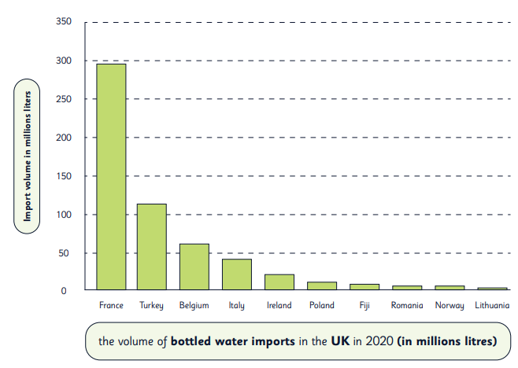
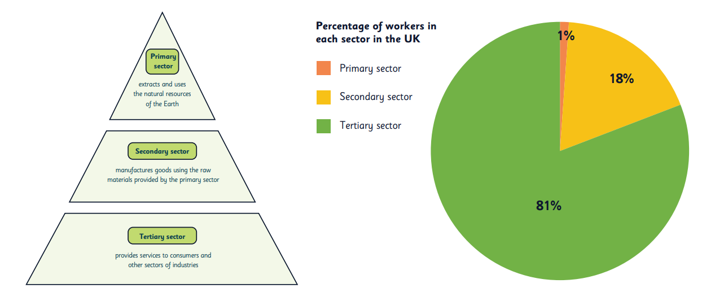
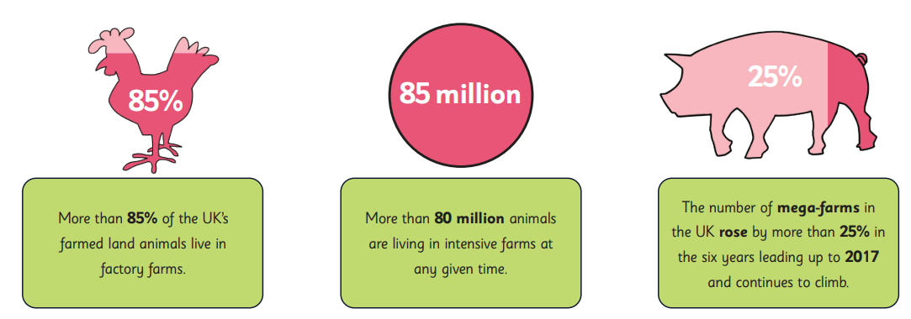
Year 6
Geography – Economic Activity of the UK
Key Learning
Typically, urban areas like towns and cities are made up of more human features (shopping centres, hospitals and stadiums) to accommodate the needs of the larger populations who live there. On the other hand, more of the land in rural areas like villages and hamlets tends to be more natural or used for agriculture.
People have jobs to earn money to buy the things they need or want. However, some of their wages also go into the tax to the government. This tax money contributes to the economy. When more people are working and get paid higher wages, more money is spent on goods and services and more money is given to the government in tax. More money goes into the economy when a company's profits are high.
Agriculture is farming and the methods used to raise and look after crops and animals. It’s one of the UK’s major industries. Farming aects everyone as it helps feed the population. There are dierent types of farming: arable, pastoral, and mixed farming - and dierent areas are better suited for certain types of farming. This depends on the weather, the land’s topography, and the soil’s condition.
Energy must be generated or captured before it can be used, and it exists in many dierent forms. Electrical energy is associated with the tiny units called atoms that make up everything in the universe. Heat and light are also forms of energy. One form of energy can also be transferred into another. In a lightbulb, electric energy is changed to light and heat.
Access to clean water and sanitation is important to prevent the spread of disease. While some parts of England and Wales enjoyed piped water supplies as early as the 15th century, it was only in the late 18th century that piped water was available to the vast majority of the population. Some years later, the widespread building of sewers allowed many people to access adequate sanitation for the first time.
No single country has everything it needs, so countries must trade with each other by importing and exporting goods and services. Sometimes, countries group together to help increase the volume of trade. The European Union (EU) is one example of a trading group (or trading bloc).
Key Vocabulary
Agriculture | farming, including growing crops or rearing animals for food, wool and other products
Distribution | arrangement or location of something
Economy | how money is made and spent in a particular area. This could be within a country or across the world.
Industry | activities that produce or supply goods or services
Primary Sector | Extracts and uses natural resources
Secondary Sector | Manufactures good using the raw materials produced by the primary sector
Tertiary Sector | Provides services to consumers and other areas of industry
Population | he number of people living in an area
Resources | the items that are available to use
Rural | places where there are more natural spaces and fewer people
Topography | the study of the shape and physical features of the land detailed description of the surface features of a region
Urban | built-up places like towns and cities where there are more people
How can the UK make it’s industries more sustainable?
What can effect the economic activity of the UK?
Which sector would you like to work in and why?

