Slide 1

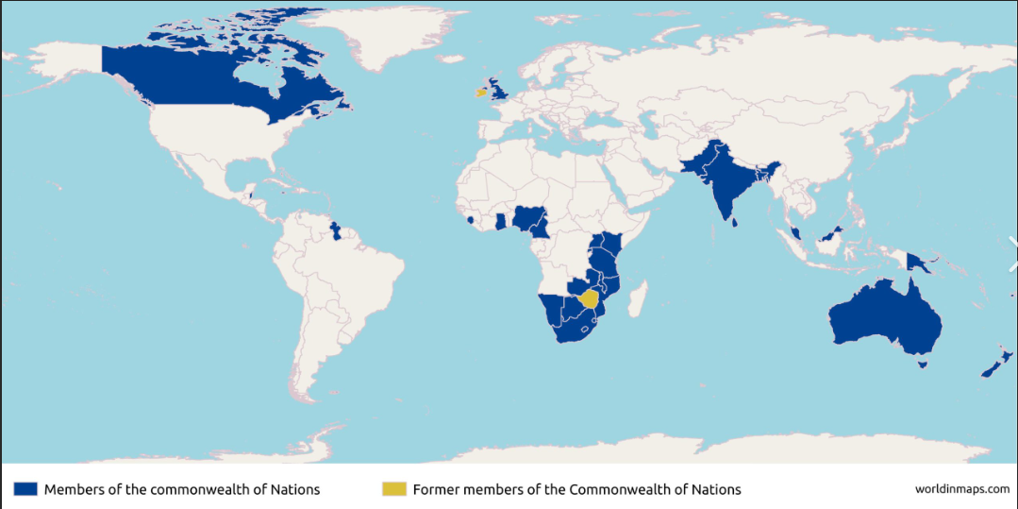
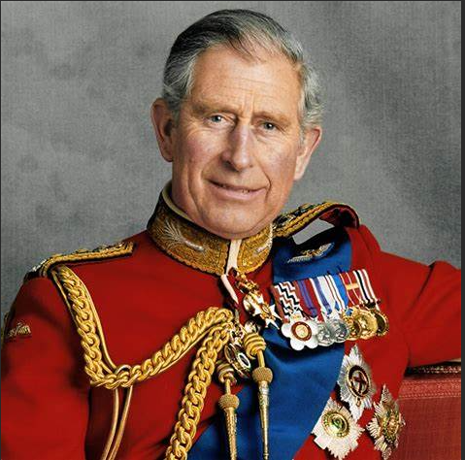
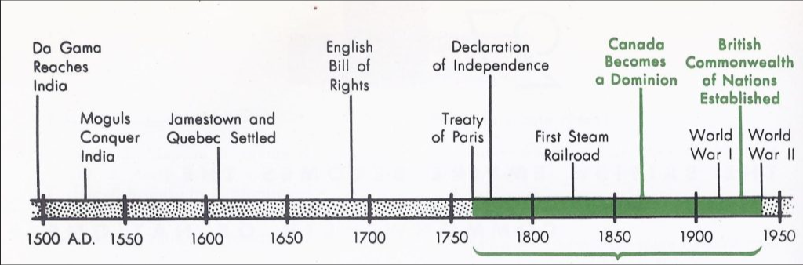
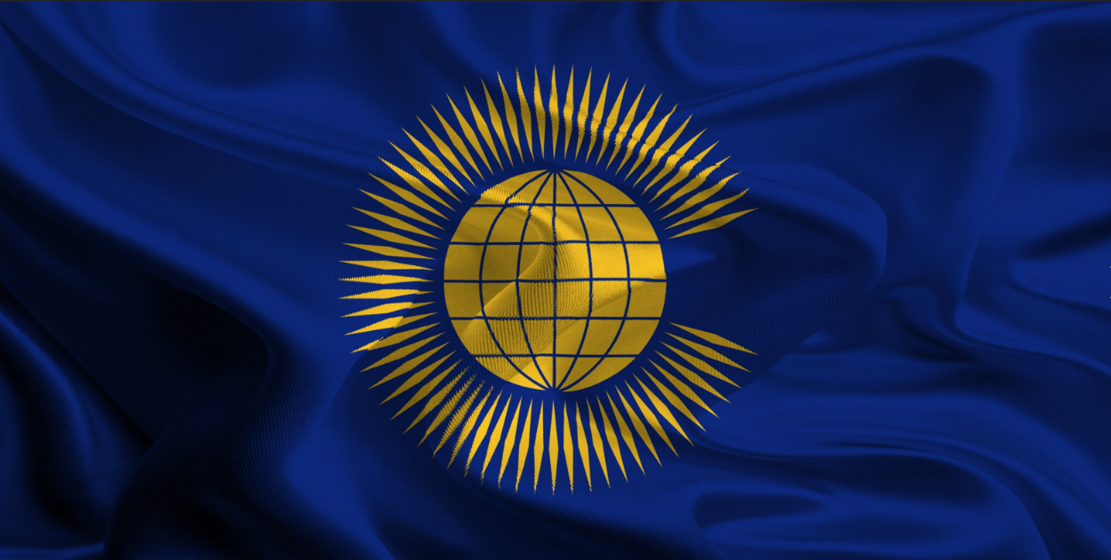
Year 6
History and Geography – The Commonwealth
Key Learning
The British Commonwealth was established in 1931. It became known as the Commonwealth later in the twentieth century.
The Commonwealth is a voluntary association of 56 independent and equal countries in Africa, Asia, the Americas, Europe and the Pacific.
The Right Honourable Patricia Scotland KC is the 6th Commonwealth Secretary General.
The reigning British monarch is the head of the Commonwealth.
The Commonwealth Games were first held in 1930 and are a multi-sport event which happen every four years. Athletes from the Commonwealth of Nations come together to compete.
Key Vocabulary
Civil Rights | The rights of citizens to political and social freedom and equality
Commonwealth | A voluntary association of 56 independent and equal countries
Democracy | A system where the government is elected by the whole population or eligible members
Freedom | Having the power to act, speak or think as one wants within the law.
Monarchy | A form of government with a king or queen at its head.
Prime Minister | The leader of an elected government.
Parliament | An assembly of people who make the laws for a country.
Rights | The freedoms that everyone in the world is entitled to.
Slave | A person who is the legal property of another and is forced to obey them.
Trade | The buying and selling of goods and services.
Empire | A group of countries ruled by a single person, government or country.
Military | The armed forces of a country.
Power | Having control or command over people.
Why was the Commonwealth established?
How is the Commonwealth different from the British Empire?
What do you think are the advantages and disadvantages of the Commonwealth?

