Slide 1

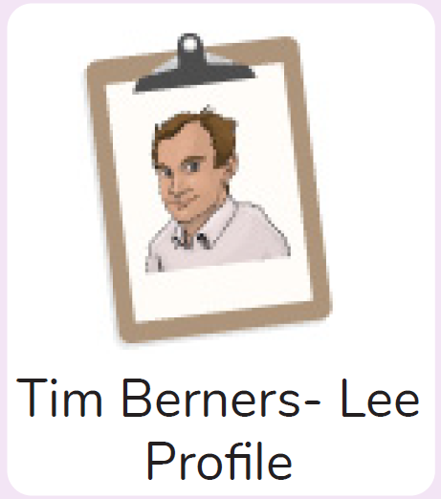
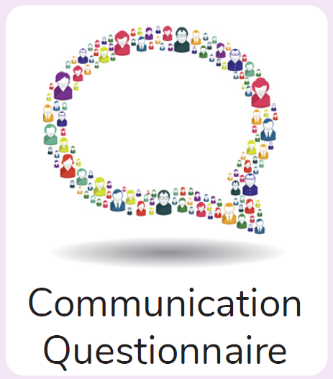

Year 6
Computing – Networks
Key Learning
To learn about what the Internet consists of.
To find out what a LAN and a WAN are.
To find out how the Internet is accessed in school.
To research and find out about the age of the Internet.
To think about what the future might hold.
Key Vocabulary
Hub\Switch | The connection point for networks where data packets from many locations converge and are then sent out to different devices.
Internet | A global computer network providing a variety of information and communication facilities consisting of interconnected networks using standardized communication protocols.
Local area network (LAN) | A computer network that links devices within a building or group of adjacent buildings, especially one with a radius of less than 1 km.
Network | Several interconnected computers, machines, or operations.
Router | A device which forwards data packets to the appropriate parts of a computer network.
Wide area network (WAN) | A collection of local-area networks (LANs) or other networks that communicate with one another over a large physical area or even globally.
World Wide Web | An information system on the Internet which allows documents to be connected to other documents by hypertext links, enabling the user to search for information by moving from one document to another.
Wi-Fi | A facility allowing computers, smartphones, or other devices to connect to the Internet or communicate with one another wirelessly within a particular area.
What is the difference between the Internet and the World Wide Web?
What is the difference between a LAN and a WAN?
Who is Tim Berners- Lee?

