Slide 1

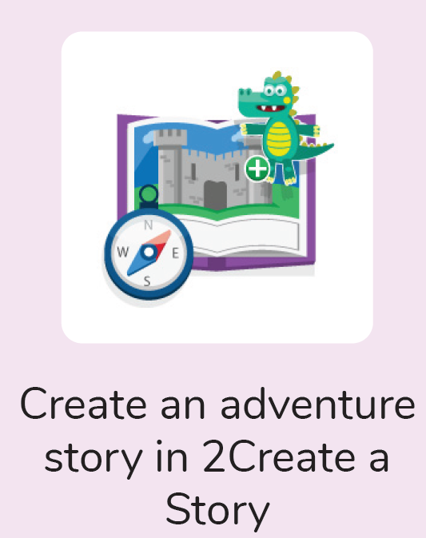
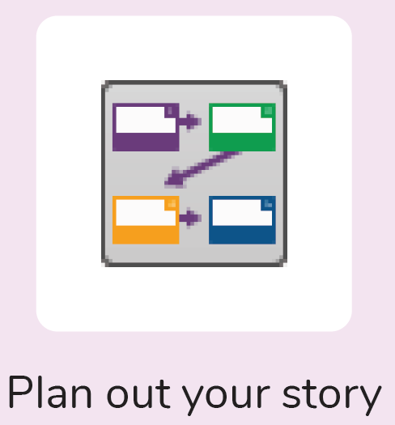



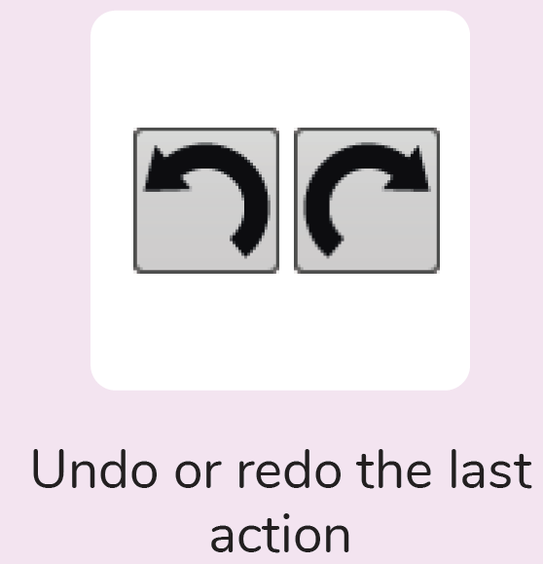
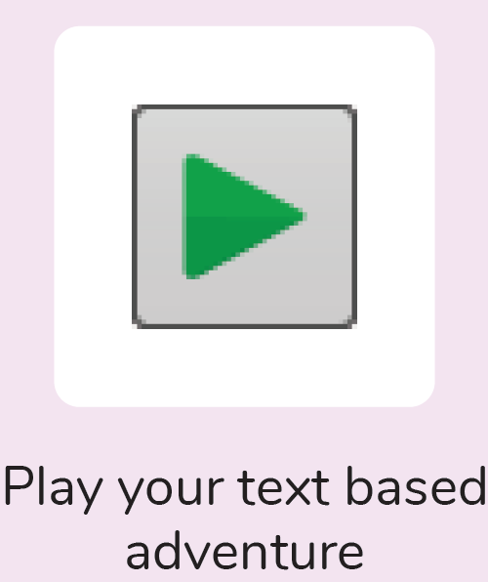

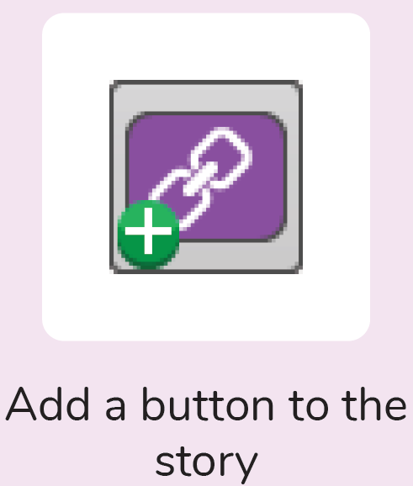
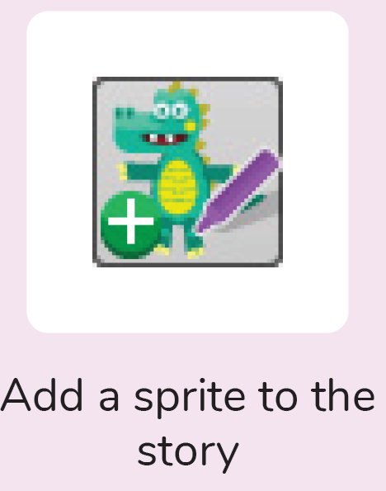

Year 6
Computing – Text Adventures
Key Learning
To find out what a text adventure is.
To use 2Connect to plan a story adventure.
To make a story-based adventure using 2Create a Story.
To introduce an alternative model for a text adventure which has a less sequential narrative.
To use written plans to code a map-based adventure in 2Code.
Key Vocabulary
Debug\ Debugging | Fixing code that has errors so that the code will run the way it was designed to.
Function | In this context, a section of code that gets run when it is called from the main code. A function in a program is usually a piece of code that gets run lots of times.
Selection | When selection is used, a program will choose a different outcome depending on a condition.
Sprite | A computer graphic which may be programmed to move on-screen.
Text-based Adventure | A computer game that uses text instead of graphics.
What is a text based adventure?
Why is it important to plan a text based adventure?
How will you edit and improve your text based adventure?

