Slide 1



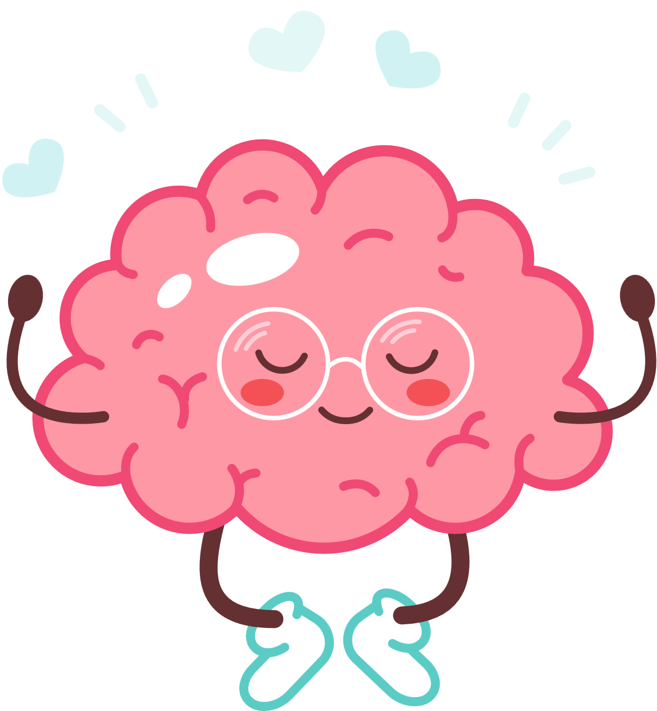

Hello and Welcome to
Brain Buddies
Based on the Brain Buddies program by Dr Helen Aspland​
Notes:
Welcome everyone to our Brain Buddies workshop!
We work in lots of different schools talking to young people about their thoughts and feelings. One of the main things we do is talk to young people about what they can do to feel more calm and in control of their feelings and this is what Brain Buddies focuses on. ​
​

Slide 2
Session 1 Aims
  Learn more about emotions
  Meet the Brain Bully!

Slide 3
  True or False
  Some emotions are bad emotions.
Notes:
Explanation of helpful emotions. ​
Emotions give us information that something important is happening , they can help us to stay safe or to change a situation if we need to.​
​
EXAMPLES: - (try to get this information from the class) see snake, feel fear, your emotion of fear will help you stay away from snakes and avoid getting bitten​
Or, if your family and friends notice that you are sad after a friend moves away, your sadness can help them see that you need their love and support.​

Slide 4
False
All of our emotions are there to help us.
Anger = tells us we aren't comfortable with something and motivates us to do something about it.
Fear = helps to keep us safe.
Sadness = shows us that we care about something.
Notes:
Explanation of helpful emotions. ​
Emotions give us information that something important is happening , they can help us to stay safe or to change a situation if we need to.​
​
EXAMPLES: - (try to get this information from the class) see snake, feel fear, your emotion of fear will help you stay away from snakes and avoid getting bitten​
Or, if your family and friends notice that you are sad after a friend moves away, your sadness can help them see that you need their love and support.​

Slide 5


Emotions can be unhelpful if they happen in the wrong situations or feel too big​.
Notes:
Highlighting sometimes helpful, sometimes can confuse us if they happen in the wrong situation or if they feel too big for us to manage.​
​
EXAMPLES: - (try to get this information from the group) Friend accidentally knocked into you, think it’s deliberate, get angry, fall out​. It's ok to feel annoyed but reacting in a very angry way is not the right response as it was an accident.
Have a test tomorrow, feel scared, don’t go into school, miss out on learning​. Feeling scared would be normal but that avoiding behaviour is unhelpful and can make you miss out and feel worse.
​

Slide 6
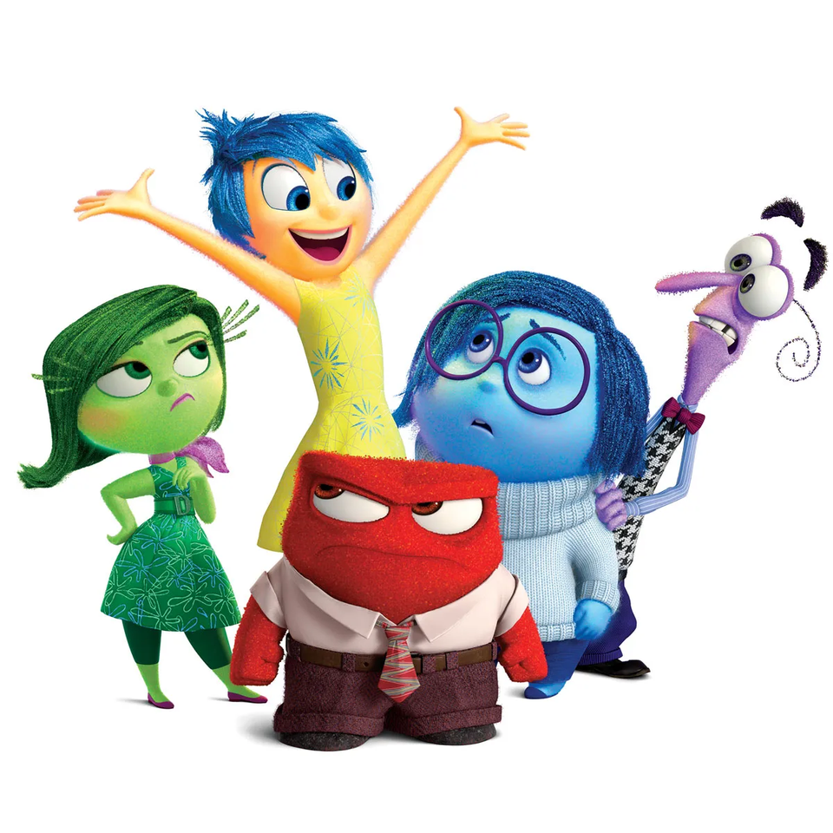
We all experience lots of different emotions
  Some make us feel comfortable and some uncomfortable​
  They can be helpful but sometimes they can trick us​
  No such thing as a bad emotion
Notes:
Summary slide:​
Range of emotions - They can be comfortable / not comfortable ​
Helpful versus unhelpful​
No such thing as a bad emotion - they can all be helpful at times. ​

Slide 7
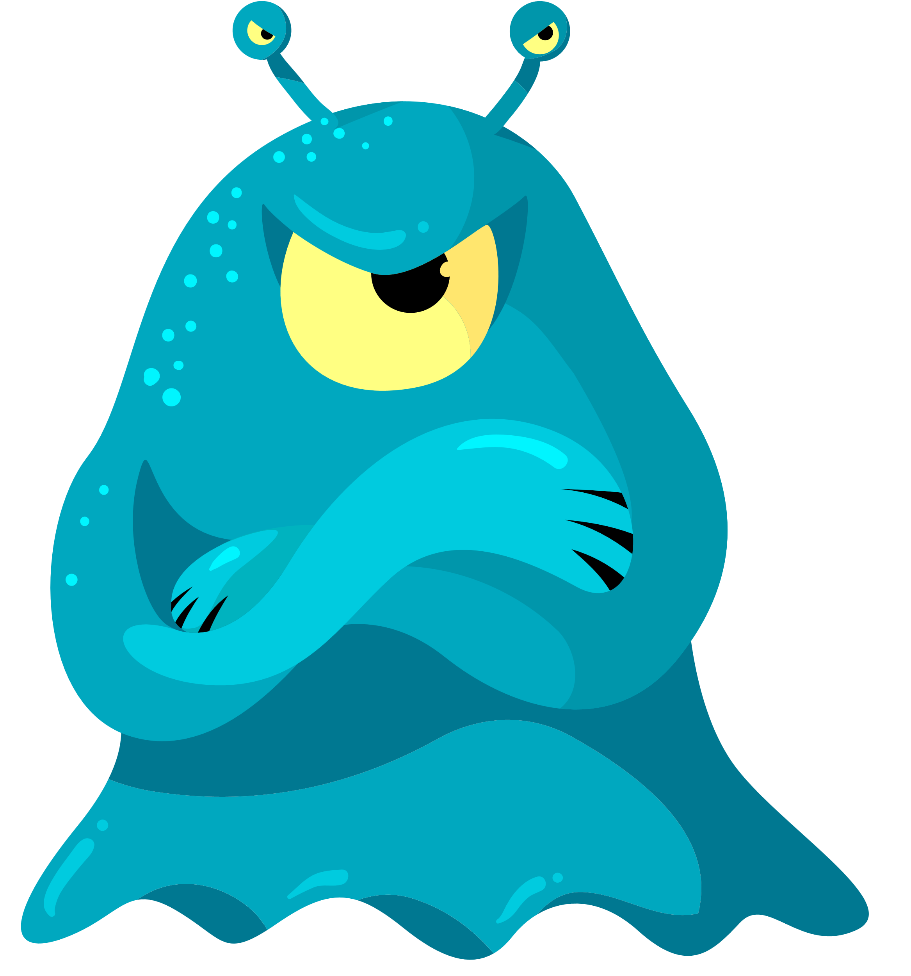
The Brain Bully!
Notes:
Imagine there is a mischievous creature called the Brain Bully who lives in our brains trying to boss us around and ruin things for us.

Slide 8
What is a Brain Bully?
  It tries to make our emotions really big and does not care if we show them at the wrong time.​
​
  Brain Bullies like to see you make bad choices.​
​
  If you notice the Brain Bully bossing you around, you can use your Brain Buddy skills to help keep it quiet.
Notes:
We all have a brain bully, everyone's different and tells us different things but in general.... (read slide)

Slide 9

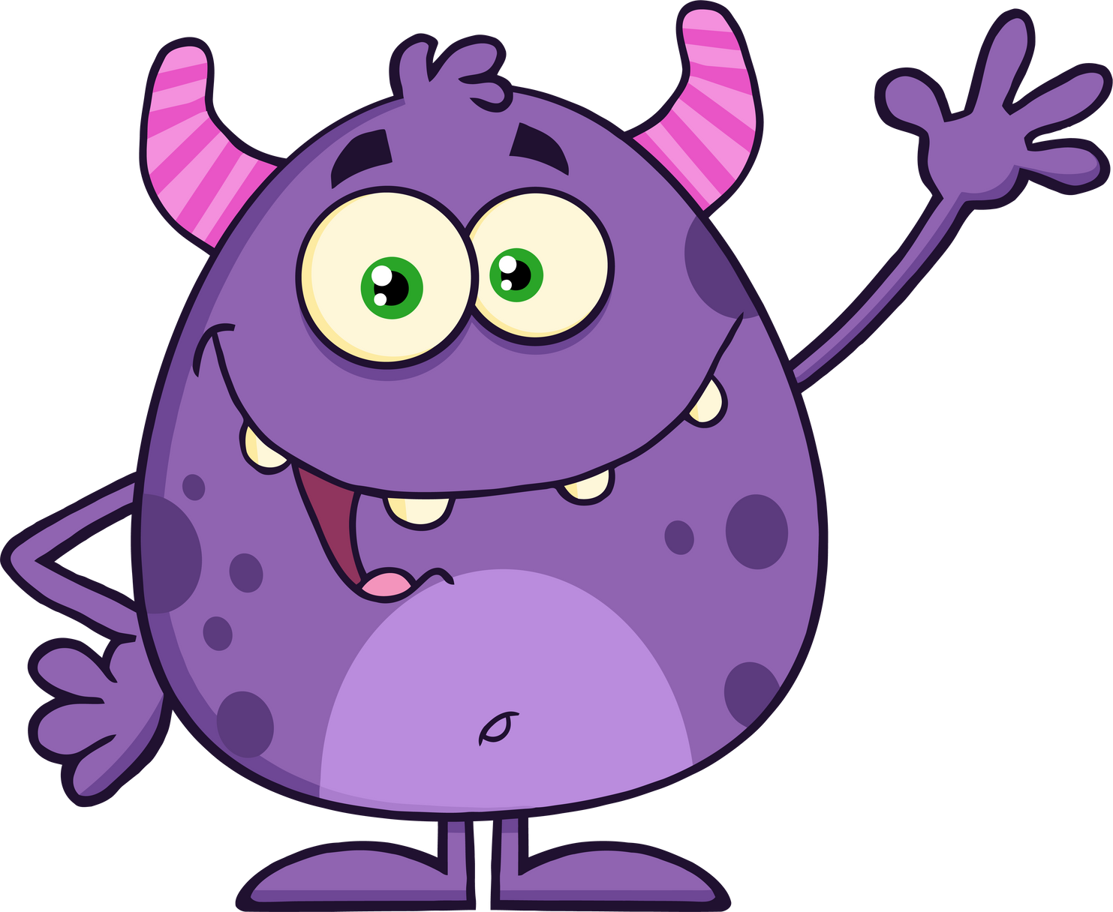
Now draw a brain BUDDY Something that says helpful things to get rid of the brain bully.
What type of things does it say to you?
You got
this!
You’re stronger than the brain bully
You’re so good at...
You are
loved

Slide 10
What does your brain BULLY look like.
What type of things does it say to you?
You can’t cope
You will fail!
Just give
up!
No-one likes
you

Slide 11
Session 2 Aims
  To learn the hand model of the brain.​
  To learn about our THINKING and SURVIVAL brains ​
  To learn what happens when we flip our lids.

Slide 12





We are going to focus on two important parts of your brain today:
Survival Brain
Thinking brain
Notes:
Explained on following slides

Slide 13
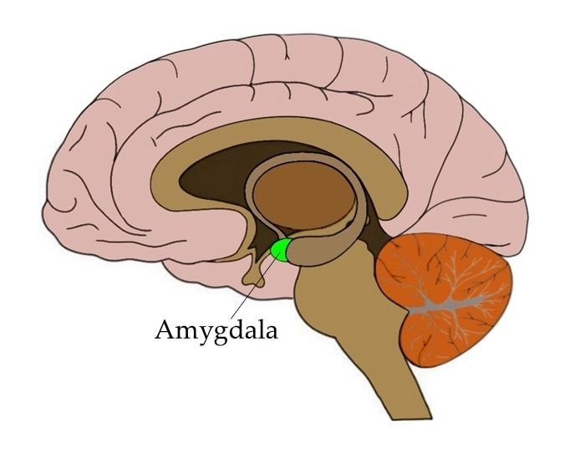
Your survival brain
  The amygdala is in the Survival part of your brain and can be thought of like a guard dog whose job is to look out for danger.
  It is where you feel your feelings. …It is super focused on keeping you SAFE.

Slide 14
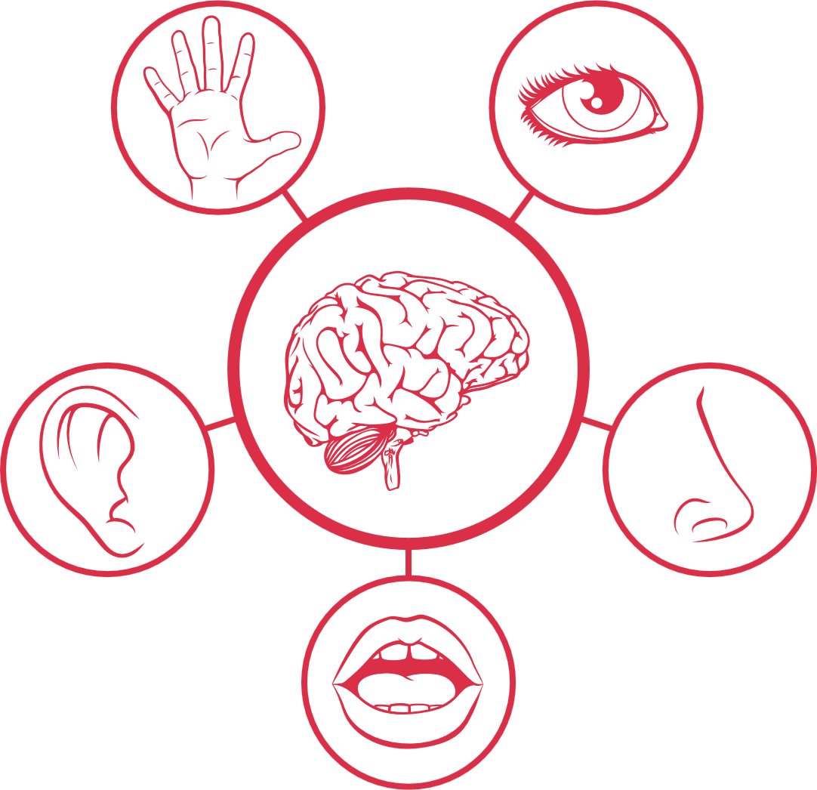
Your survival brain
  Our eyes, ears, and other sensory organs send information to the survival brain (amygdala)
  If it feels we are in danger it sends a message to activate the fight, flight and freeze response. ​
  Our bodies gets prepared to either fight the danger, run away from the danger or freeze. Usually, we freeze when fight or flight are not an option. ​

Slide 15


Your survival brain
  The survival brain can sometimes struggle between observed threats and actual dangers and can often trigger “false alarms”
  It's like a smoke alarm that is overly sensitive and goes off all the time, even when there isn't a real fire.

Slide 16
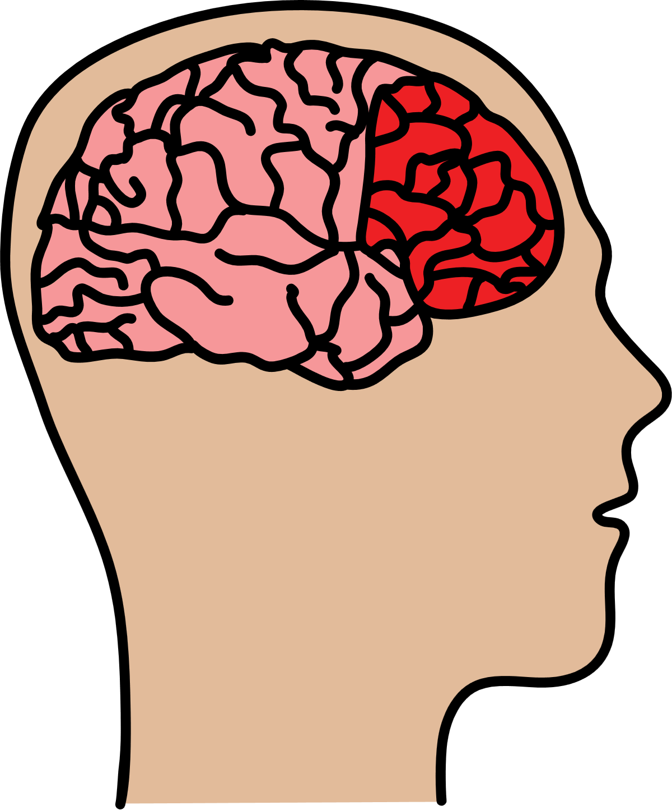
Your Thinking brain
  Your Thinking Brain is called the prefrontal cortex and lies at the very front of the brain.
  Your ‘thinking brain’ is like the wise owl of your brain.
  This part of your brain helps us make good, well balanced choices. When the survival brain is active, your thinking brain cannot help you.

Slide 17
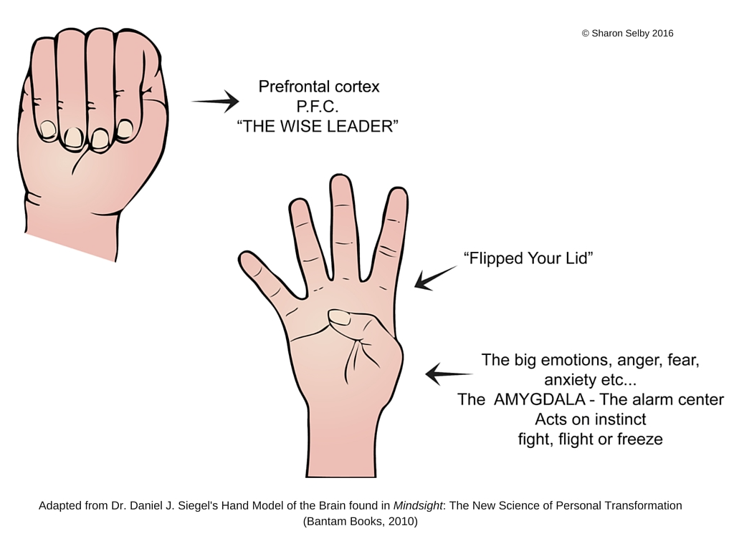

Hand brain model
Flip our lids!
Notes:
Demonstrate as talking about it.
When our wise owl thinking brain is in control our hand/brain looks like this.
Put if emotions get too big and our survival brain senses distress we can flip our lids (uncurl fingers)
The thumb is our survival brain and is in control. It barks so loudly that it can't hear the thinking brain.
Understanding what makes you flip your lid and doing strategies before it happens is going to help you stay in control and reduce the amount of times the survival brain is in charge.
If it does happen we can use strategies to help as well, but practising these beforehand will help you know what to do - your thinking brain won't be able to figure it out.

Slide 18
What things cause you to flip your lid?
Remember, this doesn’t just mean feeling angry, it can be any emotion that makes you feel too overwhelmed.
These can be things people say or do, sensory/things in your environment, things your brain bully might tell you!
Notes:
Booklet work

Slide 19
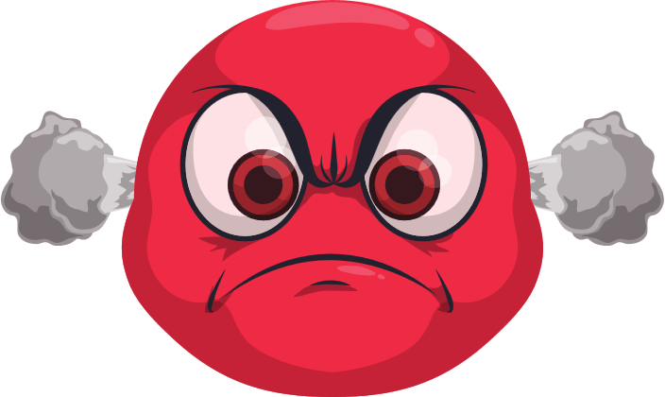
Why is it unhelpful to
flip our lids?
  What might happen?​
  How might we feel?​
  How might other people feel?

Slide 20
Session 3 Aims
  To spot our emotions by using body clues
  To understand the link between our energy levels and our emotions (zones of regulation)

Slide 21
Pay attention
to your body
Our brains are brilliant, and so are our bodies. Our bodies can give loads of signs that something is not quite right - we just need to listen.
E.g. Heart beating fast, crying, tense muscles.
Notes:
No! we ALL experience different zones throughout the day. Sometimes the zones vary by how intense the emotion is e.g. a bit cross to really angry. There are no wrong zones but we can be in a zone that doesn’t fit well with what we are doing or where we are. We can also be more likely to make poor choices when we are in the red zone – because our Thinking brain might not be working so well. There are no good zones or bad zones but sometimes extremes like the red zone or blue zone don’t match the expectations of the situation we are. ​
​

Slide 22
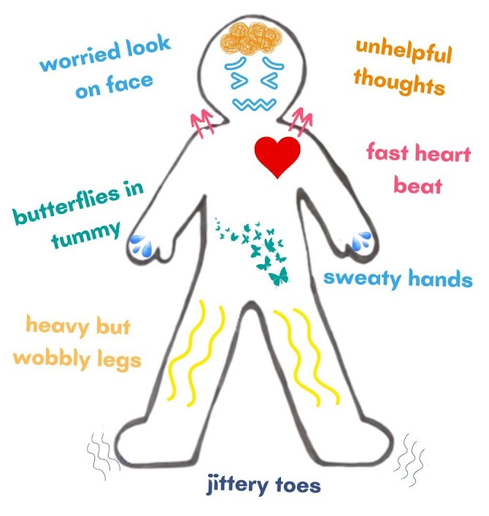
Listening to your body
Draw yourselves a body outline and write/draw what your body experiences when emotions are getting too big and you are getting close to flipping your lid.
Notes:
Remind them flipping their lids doesn't have to be anger, yelling, stomping and fight. It's that fight, flight and freeze mode so some people might go quiet and withdrawn, burst out crying etc.
Listen to your body, it's trying to help you.

Slide 23














Zones of Regulation
Sad
Tired
Shy
Upset
Sick
Bored
Numb
Confident
Focused
Calm
Loving
Loved
Happy
Proud
Brain and body moving slowly
Good to
go!
Brain and body starting to move quickly. Not as in control.
Out of Control
Angry
Terrified
Mad
Panicked
Yelling and hitting
Brain and body moving too fast! Out of control.
Scared
Worried
Jealous
Disgusted
Nervous
Stressed
Surprised
Silly
Excited
Hyper
Notes:
How are you feeling today? How do you know, are there any body clues?​
​Suggestions: happy etc – smiling, finding it easy to pay attention, interested what’s going on, feel relaxed, energetic​
Sad etc – don’t have much energy, stomach/headache​
Frustrated etc – butterflies, hot, fidgety, not very relaxed, feeling distracted ​
Angry etc – sweaty, tense, heart beating quickly, thoughts racing
Could get them to stand at each corner of the room per zone or cut out cards etc.

Slide 24

Zones toolbox
A zones toolbox contains many strategies that you can use to help you when you are in a certain zone. You might find that you have the same strategies in each zone and that is absolutely fine.
Robots, Jellyfish and Towers game
Talk to someone
Ask for a hug
Draw a picture
Go for a walk
Take a break
Give your best effort in school
Listen to your family
Be helpful
Be kind
Read a book
Play a game
Squeeze a stress ball or use a fidget toy
Talk to someone
Take a break
Do some deep breathing
Use a worry monster
Practise mindfulness
Squeeze a stress ball or use a fidget toy
Write it all down on paper and rip it up!
Do some deep breathing
Ask someone for help
Squeeze all your muscles and relax them.
Notes:
Working document, can add to it especially when doing future sessions on positive-self talk and thought challenging. So don't have to have completely finished.
Opportunity to talk about unhelpful coping strategies/safety behaviours

Slide 25
Session 4 Aims
  To understand that there are different ways of thinking about something.​
​
  To be able to identify helpful and unhelpful thoughts.​
  To know that how we think can affect how we feel and what we do.

Slide 26
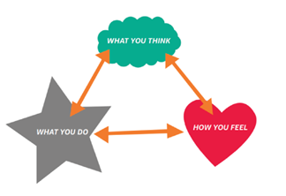
Notes:
Our thoughts are automatic, they pop into our heads whenever they choose and can be hard to ignore. They can be happy or helpful thoughts but sometimes they can also be unhelpful, upsetting and worrying. These thoughts affect how we feel and how we behave.

Slide 27
Thoughts
  We all have thoughts​
  Thoughts are words we say to ourselves without saying them out loud (self-talk)​
  Other people can’t tell what you are thinking unless you tell them​
  We have thoughts all the time ​
  We usually don’t pay attention to them and they just come to us automatically.
Notes:
Remind them flipping their lids doesn't have to be anger, yelling, stomping and fight. It's that fight, flight and freeze mode so some people might go quiet and withdrawn, burst out crying etc.
Listen to your body, it's trying to help you.

Slide 28



Thought Challenging
Is there another way I could look at this?
I can't do this!
What evidence do I have that this thought is true?
Nobody likes me!
How might someone else see this?
I'm useless!
Notes:
Sometimes when emotions get too big we experience lots of unhelpful thoughts.
We might feel like things will never get better, that we will always feel bad. We might have lots of negative thoughts like these ones.
Its important to remember that not all thoughts are true. Its therefore really important to challenge thoughts especially if you notice red, negative thoughts effecting how you feel. We do this by thinking of an alternative thought. Change it to a green more helpful way of thinking.
Practice by challenging these red thoughts in booklet. Left the booklet sheet blank so CYP can have the option to do their own red thoughts (what is the brain bully saying?) They have the thought challenging bubble in their booklets too, can show next slide to demonstrate further.

Slide 29
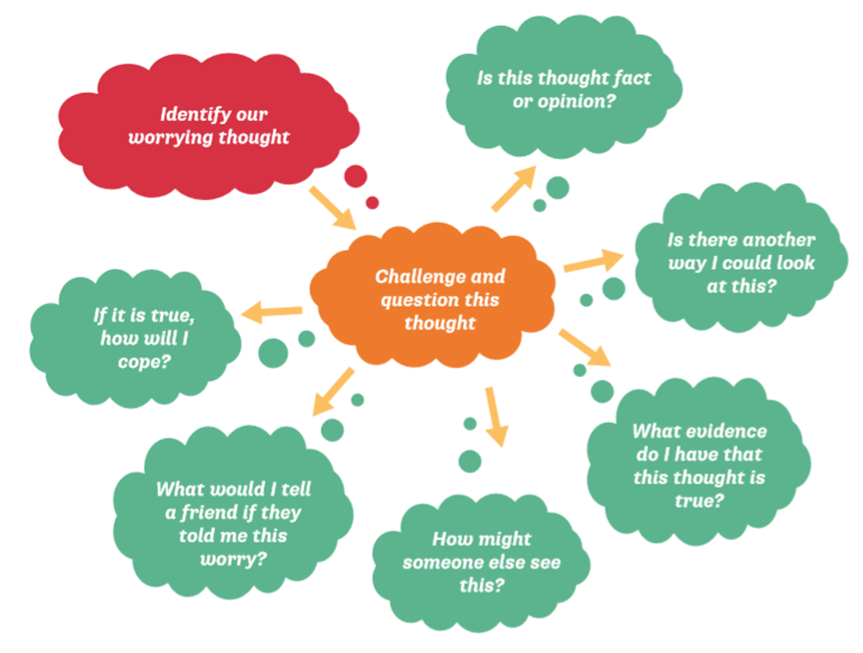
Notes:
In their booklets, to help the booklet worksheet.

Slide 30
Thought Challenging
Is there another way I could look at this?
This is too hard. I want to give up.
I'll take a break and try again later.
I am going to feel terrible forever.
This feeling won't last forever.
What evidence do I have that this thought is true?
How might someone else see this?
No one can help me right now.
My friends and family love me and will support me.

Slide 31



Sophie's friend started playing a game with another group of people at breaktime. Normally, they like to sit together and talk on their own.
"My friend doesn’t like me anymore"​
​
"I must have done something to upset her"​
​
"I don't have any friends"
"My friend just wanted to play a game today, that doesn’t mean she doesn't like me"​
​
"If I ask, maybe I could play too"​
​
"I could try to find someone else to spend time with"​
​
​
Notes:
Read the scenario.
Red volunteer to say negative unhelpful thoughts relating to this scenerio.
Green volunteer to say helpful positive thoughts.
Class to notice differences. How would each person feel? How might they behave?

Slide 32
Session 5 Aims
  Begin to understand mindfulness and that it can help us regulate our emotions​
  To learn how to use positive self-talk

Slide 33
Mindfulness
  We can spend a lot of time not living in the present day. We might worry about the future or become sad thinking about the past and forget to live in the now.
  Mindfulness practice helps you focus your attention on the present day by engaging our senses.

Slide 34
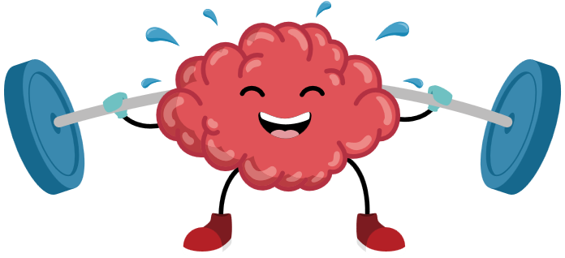
Mindfulness
  Mindfulness is a great way of training your brain.
  After 8 weeks of daily mindfulness practise, grey matter in amygdala becomes smaller and grey matter in prefrontal cortex becomes thicker.
  This means that the survival brain doesn't trigger and bark as often and you can react in a more helpful way.
Notes:
Last week we looked at our brilliant brains and that we ideally want the thinking brain in charge.
Then read slide

Slide 35
The Brain Bully!
What kind of thoughts does Brain Bully like? What do they hate? ​
Notes:
What kind of thoughts does Brain Bully like? What does he hate? ​
What it hates is when you have Helpful thoughts, because they help get rid of the Unhelpful Thoughts the Brain Bully needs to grow strong. ​
It is much easier to come up with helpful thoughts and stop the Brain Bully from bossing you around and ruining things when your Thinking Brain is in charge.

Slide 36

Positive statements and strategies to help​
Rise Worksheet
Be strong,
be you
This may be hard
but I'm going to
keep trying
I am enough and
I am worthy
I've got this
Mistakes help me
learn better
I can give it a try;
I have done new
things before
I've done this
before and it
was ok
I am strong
This feeling
will pass
I am proud
of myself
I can learn
new things
I belong
I can do
this well
I can use a
breathing strategy
I can get
through this
I'm stronger than I think
Notes:
Rise worksheet links to the positive self-talk cards on our website.
If not doing below, use next slide to explain the mantra badge, leave this slide up for those who may struggle to think of one.
OPTIONAL: I've got a jar here for your class. We are going to fill it with nice, positive, encouraging messages or tips to help when you feel your Brain Bully is in trying to take control
​Here are some suggestions on the board. ​You might like to make your own up. ​You might like to write down some jokes.​
We are going to fill the jar with positivity and then when you need it, you can select a message from the jar. You can encourage others to use the jar if you notice their about to flip their lips.
If no time, could leave a jar and explain what to do for the class teacher to do.

Slide 37

My Positive Mantra
Notes:
Now we are going to create our own positive mantra badge – a positive statement that you can say to yourself when you are in sloth or tortoise to make challenge those unhelpful thoughts and feel more confident.​
This can be something that you put in the jar but one for you to keep for yourself. It might be helpful to put on your wall at home. The brain bullies don't just stay in school.

Slide 38
Session 6 Aims
  To go through our support team.​
​
  To review what we have learned in the Brain Buddies Workshop and how it can help us in the future.

Slide 39
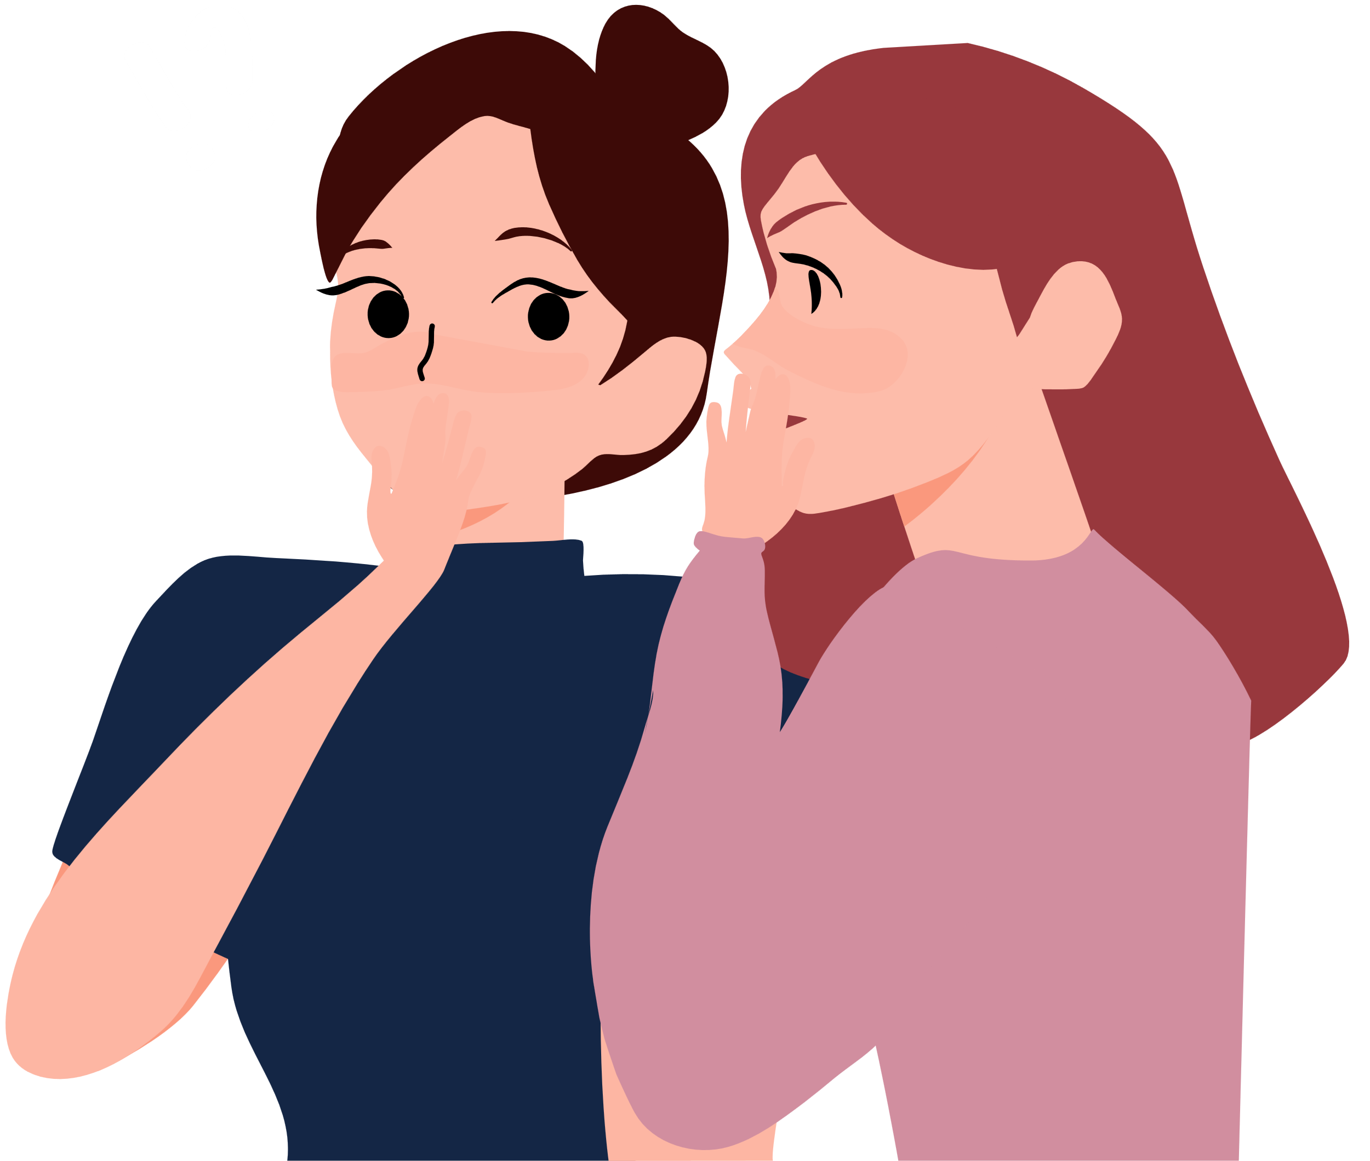
Why does it help to talk to others?​
Notes:
We’ve thought a lot about different emotions we might feel. One of the skills that can help us to manage how we are feeling is to talk to other people about it. Why does it help to talk to others? talk partners for 1 minute, gather ideas, reveal our suggestions. (next slide)
​

Slide 40

  It can make you feel better to share if you’re having a problem.​
  They might be able to give you good advice to help you.​
  Helps us to know we are not alone – other people might feel the same as we do.​
  They might be able to help us change the situation.

Slide 41


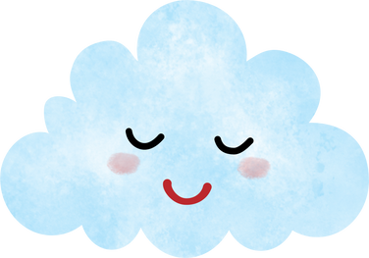



Rise video
Support Teams
Who do I have fun with?
Who calms me down?
Who cheers me up?
Who can I talk to if I'm feeling worried?
Who helps me solve problems?
There are people who can support you with however you may be feeling.
Can you think of any people you feel supported by:
  Someone you are able to talk to about your thoughts and feelings?
  Someone who you feel listens to you?
  Someone that will encourage you and help you when you feel unsure?
  Someone who helps to take your mind off how you are feeling and can help you to feel good and recharged?
Notes:
In booklet
We've practised many Brain Buddy Skills but sometimes they may not work and we need help from others.
Knowing who our support team can help us feel better, it's also good to let them know they are in your back team so they are ready to support, if possible.
You might be in somebody's support team.
Specifically comment that it is not a competition to see how many names you can write down – a few names that are really helpful is just as good. Some of us talk to lots of people and some of us don’t and one isn’t better than the other but also do say that if anyone notices they are finding it hard to think of names of people that can support them this might be a good thing to talk to a trusted adult (or whoever the school wants us to direct pupils to) about to see if you can get more support as we all need a support team to help our Brain and Bodies feel well. ​
​(Be aware this task may trigger feelings of loss and hurt for some students who are less well supported – think ahead with the teacher who this might relate to and think how these students in particular can be checked in with during the task)​
​Ask them to complete this on their own as sharing this may feel hard to pupils with little support (peer or family networks). Facilitators circulate and check in with students as they complete this.
​

Slide 42
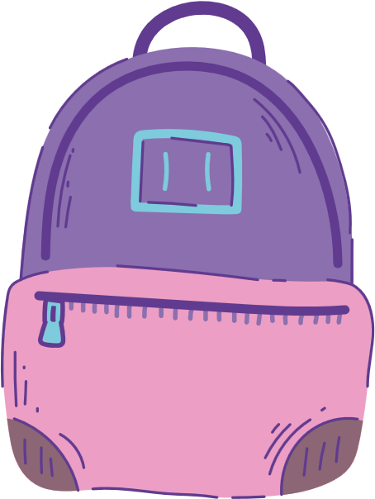

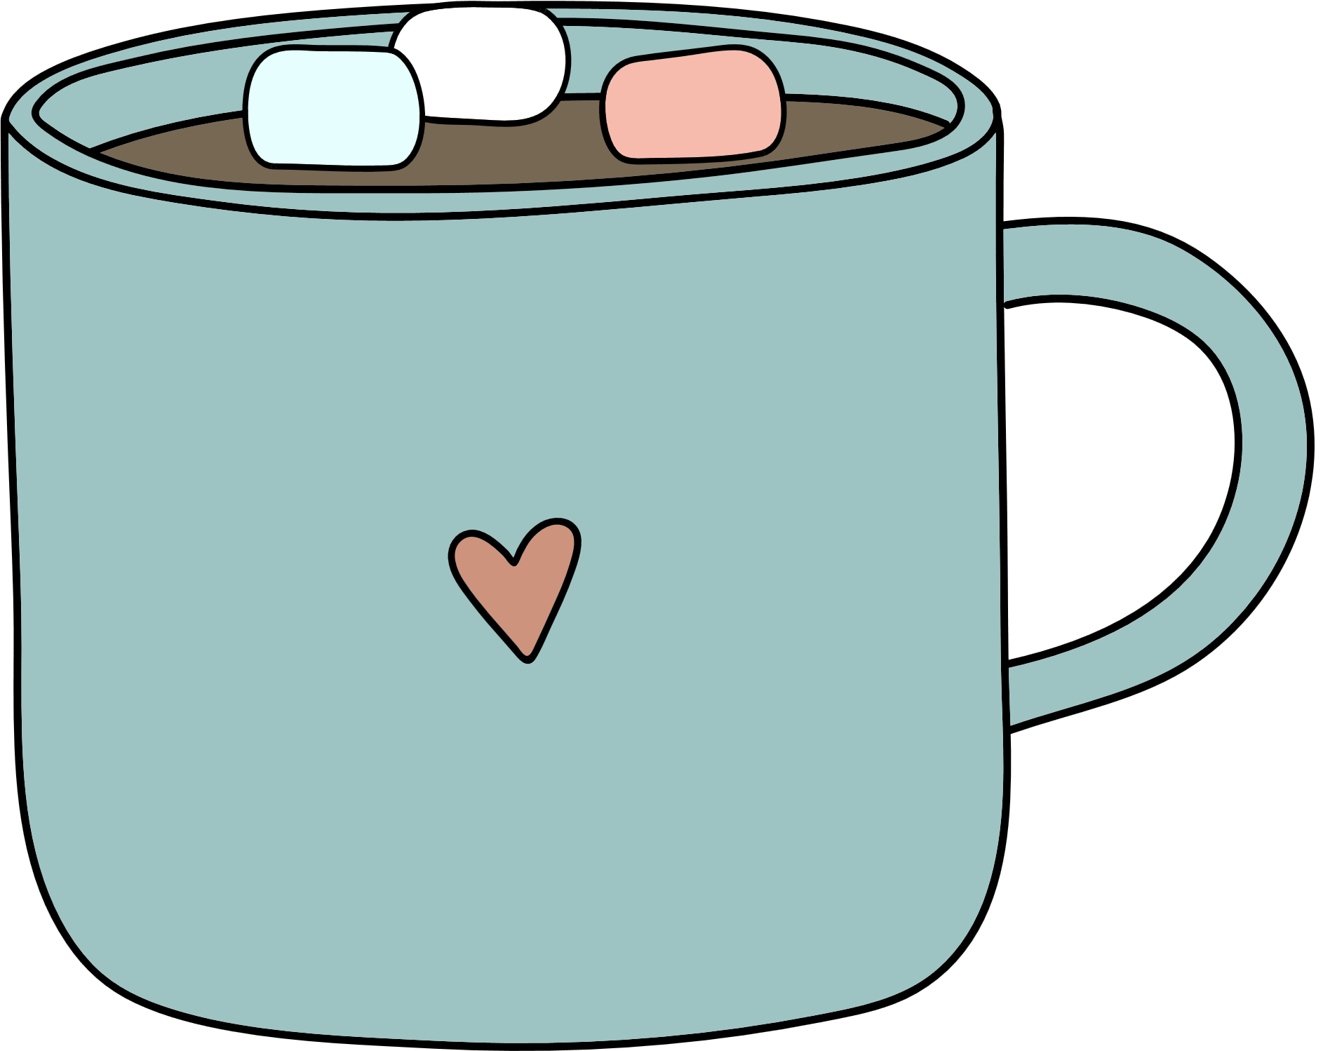
Chair Push Ups
Sit with your feet flat on the floor. Push your bottom up from the seat of the chair with flat palms.
Hot Chocolate Breathing
Pretend that you have your hands wrapped around a mug of hot chocolate.
Breathe in through your nose for 4 seconds as though you are smelling the delicious chocolatey smell.
Hold for 5-10 seconds and repeat if needed.
Then breathe out through your mouth for 4 seconds as though you are blowing it to cool it down.
Notes:
Booklet - in the booklet but before previous activity for space/not waste paper.
We will end each session with helpful calming strategies – some they might like, some not so much, their job is to find out what works for them. These will be our Brain Buddy skills and you can tell this by the backpack in the top right corner! Our Brain Buddy's Backpack!
How do we learn new skills? – practice. Need to practice each skill several times to see what they think of it.​​
​Some activities can help us whether we have too much energy in our bodies or too little – like Chair Push up’s – let’s try it​​
Sit with your feet flat on the floor. Push your bottom up from the seat of the chair with flat palms. Not too far up or you might hurt yourself. Hold for 5-10 seconds. (Demonstrate this and count) ​​
How does that feel in your body? Try it again if you like? Do you feel calmer or more alert? ​​
​One skill is deep breathing –Introduce the hot chocolate idea e.g. Pretend that you have your hands wrapped around a mug of hot chocolate. Breathe in through your nose for 3 seconds as though you are smelling the delicious chocolatey smell. Then breathing out through your mouth for 3 seconds as though you are blowing it to cool it down. Keep doing this 4/5 times until you start to feel yourself relax. ​

Slide 43
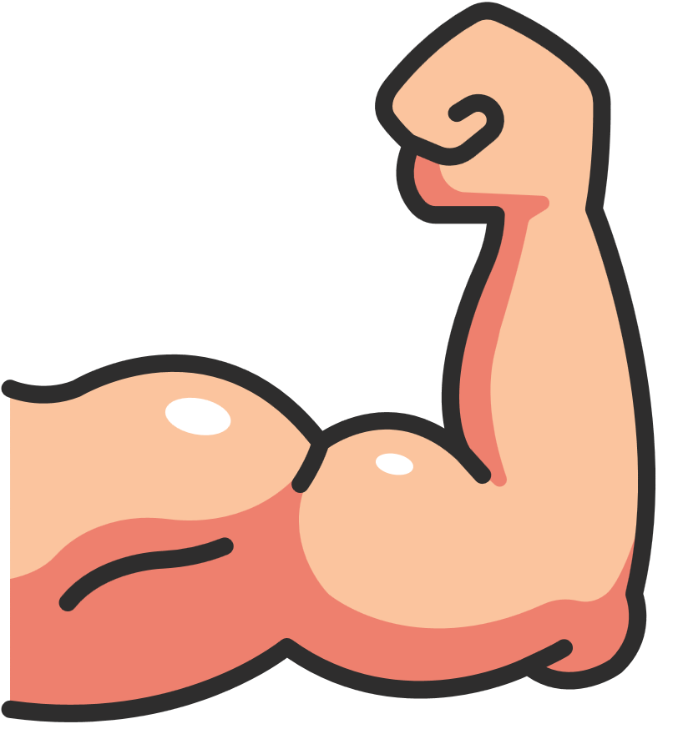

Squeeze
Squeeze all your muscles and breathe in. Hold it in for a count of 10. Breathe out slowly as you relax your muscles. Repeat.
Square breathing
You can use your finger and trace around a square object, or trace an imaginary square with your finger.
Breathe in slowly for 4 seconds and out slowly for 4 seconds. Repeat if needed.
Repeat if needed.
Notes:
Time to look in our Brain Buddy's Backpack this week and practise some skills. How did people find last week's? - Hot choc and chair push up?
Squeeze can be done differently but squeezing individual parts of the body e.g. feet, then legs ... as long as they take slow deep breaths, breathing in as they tense and out as they release.
Square breathing can be down different - in, hold, out. A side could equal 1sec or 4secs etc.

Slide 44

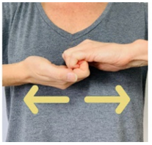
Palm Push
Face your palms together
Push them firmly
Hold for 10 seconds
Repeat
Finger Pull
Put one hand palm up and one hand palm down.
Touch your fingers together and curl so they are locked together.
Pull them apart and hold for 10 seconds.
Notes:
Time to look in our Brain Buddy's Backpack this week and practise some skills. How did people find last week's? - Hot choc and chair push up?
Squeeze can be done differently but squeezing individual parts of the body e.g. feet, then legs ... as long as they take slow deep breaths, breathing in as they tense and out as they release.
Square breathing can be down different - in, hold, out. A side could equal 1sec or 4secs etc.

Slide 45



Happy Memories
When times are tough, think of a time when you felt happy.
Research shows we can boost our mood by reflecting on a positive memory.
Rip!
Get all the anxious or angry thoughts out of your mind by writing them down.
When you've written them all down, rip the paper into tiny pieces and put it in the bin.
Notes:
Time to look in our Brain Buddy's Backpack this week and practise some skills. How did people find last week's? - Hot choc and chair push up?
Squeeze can be done differently but squeezing individual parts of the body e.g. feet, then legs ... as long as they take slow deep breaths, breathing in as they tense and out as they release.
Square breathing can be down different - in, hold, out. A side could equal 1sec or 4secs etc.

Slide 46

Thoughts Aren't Facts
Just because you think it, does not make it true.
Can you pop your green glasses to challenge and change your thought?
Is there another way to think about the situation?
If it is true, how will you cope? Will it matter in a week's time? A month's time?
Distraction
When we cannot do anything about our thoughts and worries, then it is sometimes useful to distract ourselves.
You could play:
  What would you do if...: you had a superpower, won the lottery?
  A-Z: Find 5 things for every letter of the alphabet.
  10s - 10 colours in the room, 10 Disney films...
Notes:
Time to look in our Brain Buddy's Backpack this week and practise some skills. How did people find last week's? - Hot choc and chair push up?
Squeeze can be done differently but squeezing individual parts of the body e.g. feet, then legs ... as long as they take slow deep breaths, breathing in as they tense and out as they release.
Square breathing can be down different - in, hold, out. A side could equal 1sec or 4secs etc.

Slide 47







Grounding Techniques
5, 4, 3, 2 ,1
Be a Tree
I am firmly planted. I feel my feet rooted to the ground. My back is a strong trunk helping me feel stable in the moment. I feel my toes connecting with the ground. My arms are my branches. I feel them reach out into the world.
5 things I can see
4 things I can hear
3 things I can smell
2 things I can touch
1 thing I can taste
Notes:
Time to look in our Brain Buddy's Backpack this week and practise some skills. How did people find last week's?
Do you remember when we talked about mindfulness and how it can help us focus on the present moment. Grounding techniques help bring you back to the present day - to reconnect with you and your surroundings.

Slide 48





Find us online...
www.youtube.com/@rise-ne
Hope you enjoyed this session!
@rise_mhst
@rise.ne
Check out the RISE YouTube channel for more wellbeing videos!
rise.childrenssociety
.org.uk/

